Slide 1
The influence of the cryostatting technology evolution on the efficiency of WBC units
Vasilenok A.V., Baranov A.Yu., Malysheva T.A., Kirilov D.N.

Slide 2
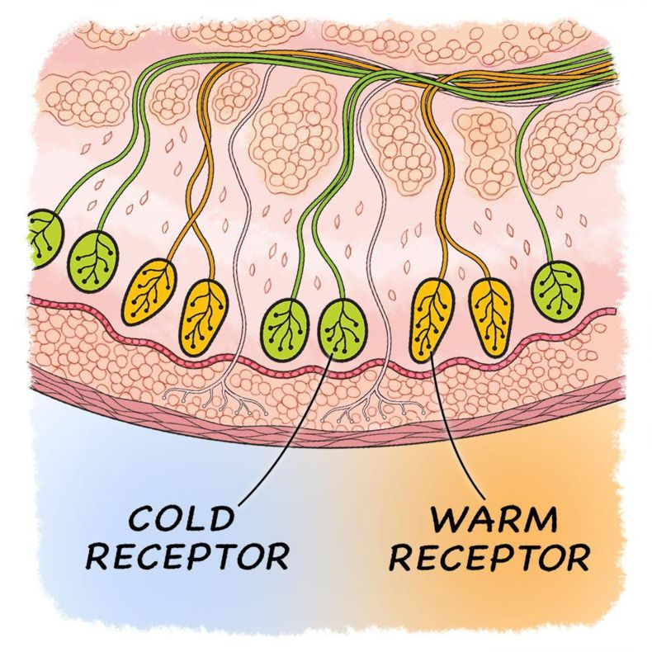
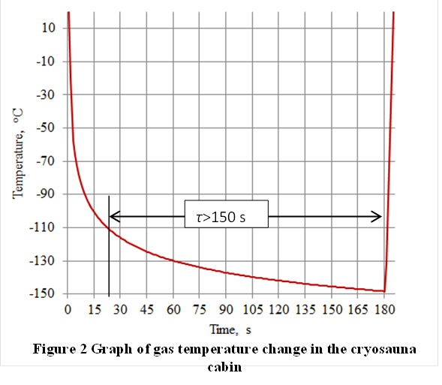
2
The influence of the cryostatting technology evolution on the efficiency of WBC units
WBC is a medical technology based on stimulation of the patient's cold skin receptors.
Cold receptors irritate subcooling of the surface to a subterminal temperature level(t_{s}→-2ºC)
The gas temperature determines the intensity of heat removal therefore most researches in the field of WBC technology pay particular attention to the gas temperature.
-170^{о}С
30 s to fill WBC zone with -110^{о}С

Slide 3
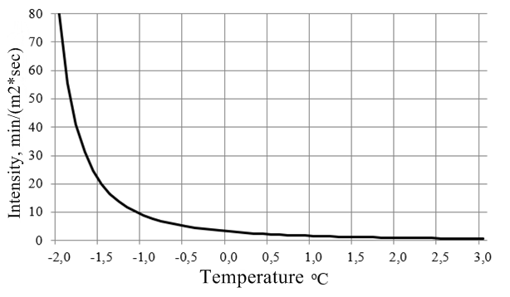
The influence of the cryostatting technology evolution on the efficiency of WBC units
3
The basic principle of the WBC unit operation is to supercool the surface of the human skin to a subterminal temperature level

Slide 4
The influence of the cryostatting technology evolution on the efficiency of WBC units
4
clinical application of the WBC
ALOPECIA
ALLERGY
DERMATITIS
STROKE
CLIMACS
BURNS
ABSTENTION
OBESITY
GOUT
PSORIASIS
CELLULITE
EPILEPSY
INFERTILITY
ASTHMA
ARTHRITIS
DIABETES
INFARTT
NEURODERMIT
OSTEOPOROSIS
POLLINOZ
Fractures
INJURIES
ECZEMA

Slide 5
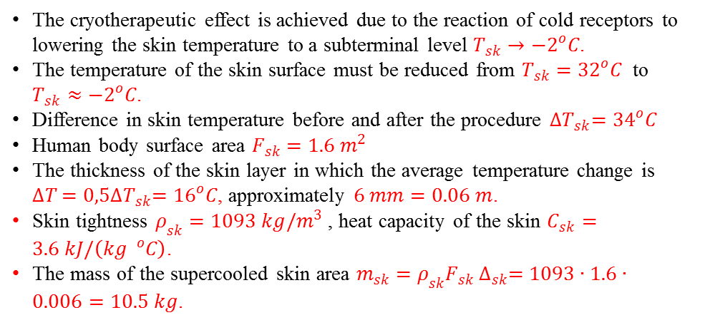
The influence of the cryostatting technology evolution on the efficiency of WBC units
5
CRYOTHERAPY FROM THE POINT OF VIEW OF HEATING ENGINEERING
(Thermal Efficiency Theses)
The cryotherapeutic effect is achieved due to the reaction of cold receptors to lowering the skin temperature to a subterminal level $T_{sk}→−2^{o}C$.
The temperature of the skin surface must be reduced from $T_{sk}=32^{o}C$ to $T_{sk}≈−2^{o}C$.
Difference in skin temperature before and after the procedure ${∆T}_{sk}=34^{o}C$
Human body surface area $F_{sk}=1.6 m^{2}$
The thickness of the skin layer in which the average temperature change is ${∆T}_{ }=0,5{∆T}_{sk}={16}^{o}C$, approximately $6 mm=0.06 m$.
Skin tightness $ρ_{sk}=1093 kg/m^{3}$ , heat capacity of the skin $C_{sk}=3.6 kJ/\left(kg ^{o}C\right)$.
The mass of the supercooled skin area $m_{sk}=ρ_{sk}F_{sk} ∆_{sk}=1093∙1.6∙0.006=10.5 kg$.

Slide 6
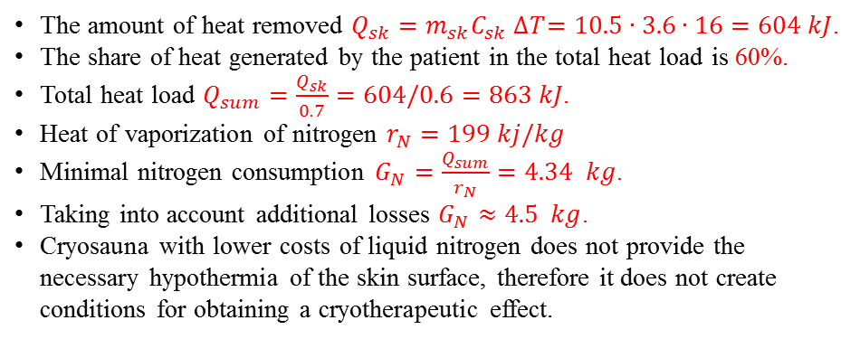
The influence of the cryostatting technology evolution on the efficiency of WBC units
6
CRYOTHERAPY FROM THE POINT OF VIEW OF HEATING ENGINEERING
(Thermal Efficiency Theses)
The amount of heat removed $Q_{sk}=m_{sk}C_{sk} {∆T}_{ }=10.5∙3.6∙16=604 kJ$.
The share of heat generated by the patient in the total heat load is 60%.
Total heat load $Q_{sum}=\frac{Q_{sk}}{0.7}=604/0.6=863 kJ$.
Heat of vaporization of nitrogen $r_{N}=199 kj/kg$
Minimal nitrogen consumption $G_{N}=\frac{Q_{sum}}{r_{N}}=4.34 kg$.
Taking into account additional losses $G_{N}≈4.5 kg$.
Cryosauna with lower costs of liquid nitrogen does not provide the necessary hypothermia of the skin surface, therefore it does not create conditions for obtaining a cryotherapeutic effect.

Slide 7
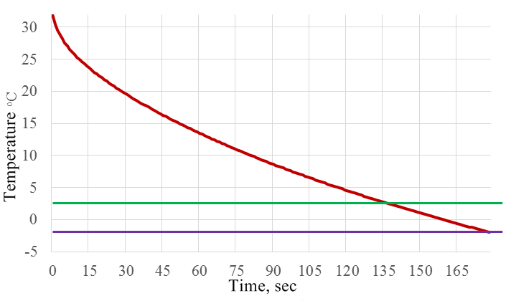
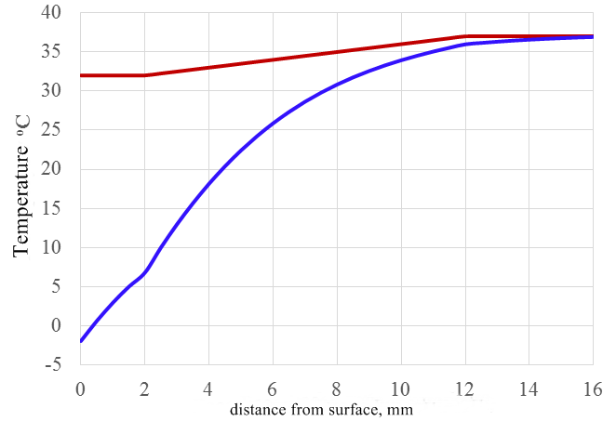
7
The influence of the cryostatting technology evolution on the efficiency of WBC units

Slide 8
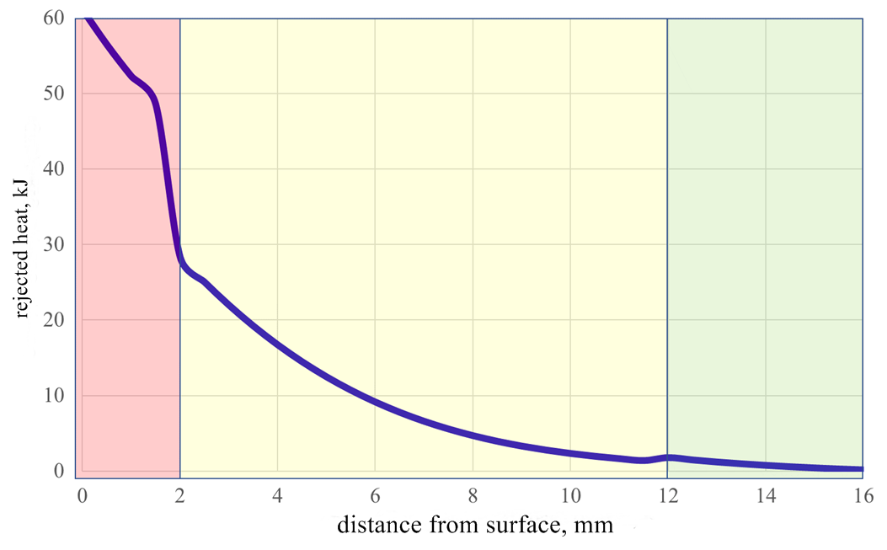
8
The influence of the cryostatting technology evolution on the efficiency of WBC units

Slide 9
The influence of the cryostatting technology evolution on the efficiency of WBC units
9
CONCLUSIONS
The WBC thermophysical theory is formulated
Methods for calculating the effects that occur along with the body contact with cryogenic gas are proposed
The proposed theory is confirmed by numerous studies at the ITMO University
The main postulates of the theory are suggested as a subject of professional discussion, which opens it for extensions and clarifications
The purpose of such a discussion could be the development of a universally recognized tool for the continuation of research in the field of cryogenic medical technologies

Slide 10
Thank you for your attention!
www.ifmo.ru

