Slide 1
ACCUMULATION AND STORAGE OF LNG UNCOOLED
Baranov Alexander
abaranov@corp.ifmo.ru

Slide 2
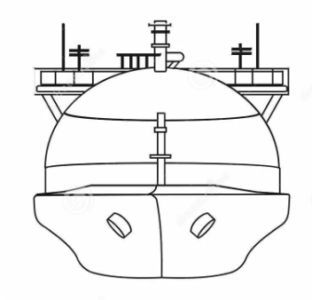
LNG PRODUCTION
Q_{sek}>550 MWt
NG
LNG
g’= 317 кг/с , Р=0,11 МPа,
Т= 111К
g= 317 kg/s Р=6,5 МPа, Т= Т_{En}
n_{эл}>0,215 (kWt h)/kg
N_{эл}>250 MWt

Slide 3
LNG PRODUCTION
W2
G5
MR10
P2
MR9
IV
I
G4
V
W1
P5
P4
P3
P1
MR6
G3
G1
Propane Pre-cooling System
G2
MR2
MR8
MR3
MR7
MR5
W2
MR4
III
II
W1
MR1

Slide 4
LNG STORAGE TANKS
BALTIC LNG
4 TANKS
«YAMAL LNG»
2 TANKS
78 m
48 m
30 m
40000m³
160000m³
42 m
Evaporation loss 17,2 17 tons per day
0,09%
Evaporation loss 24 tons per day
0,03%
Total at the plant 68,8 tons per day
Total at the plant 48 tons per day

Slide 5
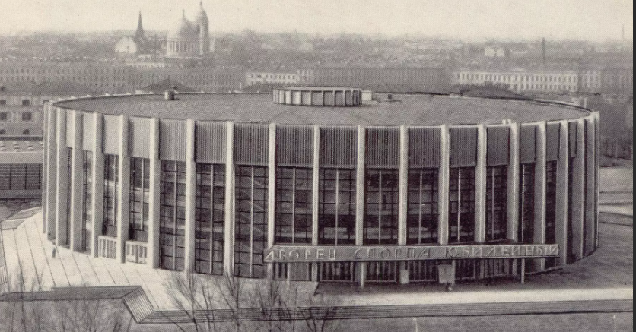
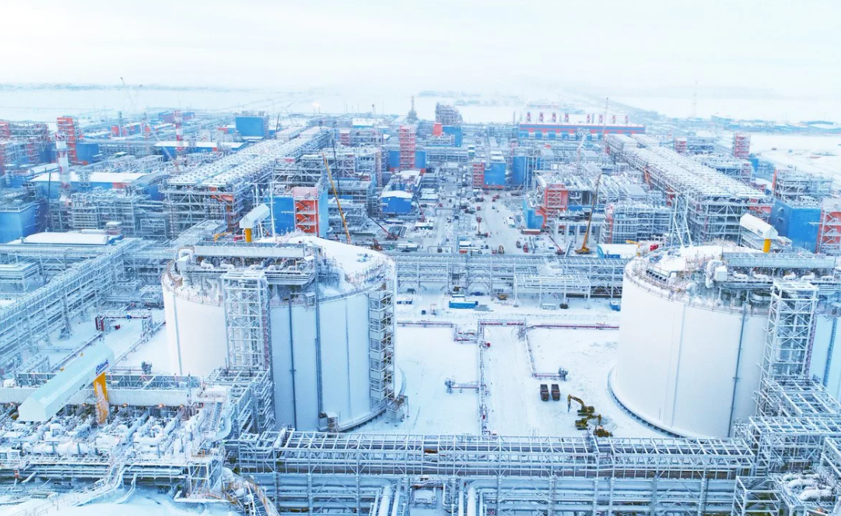
PALACE OF SPORT "JUBILEE"
Diameter 91 m, Height 22 m
78 m
30 m
160000м³
56 m
40000м³
«YAMAL LNG»

Slide 6
STORAGE AND DISPOSAL OF LNG
Н$акопление τ≤72 hr$
В$ыдачаτ≤24 hr$
$${ g}_{St}$$
$${ g}_{St}$$
$${ g}_{Sup}$$
$${ g}_{Sup}$$
$${ g}_{Del}$$
$$Q_{En}$$
$$Q_{En}$$
$$V_{L}$$
$$V_{L}$$
$$Q_{p}$$
${ g}_{Del}=0$;
${ g}_{Sup}$=const;
$Q_{En}$≈const;
${ g}_{Del}>0$;
$Q_{p}$>0;
$V_{L}$=f($τ$);
$V_{L}$=$\frac{G_{L}}{ρ_{L}};$
$$\frac{{∂G}_{L}}{∂τ}={∂g}_{x}+{∂g}_{y}+{∂g}_{z};$$
$$\left.{∆G}_{L} ={\left(∆g\right.}_{x}+{∆g}_{y}+{∆g}_{z}\right)∆τ;$$
$$\left.{ G_{L}^{′}}_{ }=G_{L} {+\left(∆g\right.}_{x}+{∆g}_{y}+{∆g}_{z}\right)∆τ;$$
$${∆g}_{x}=0;$$
${ ∆g}_{y}={ g}_{Sup}$-${ g}_{Del}$
$$x=\frac{h_{L}−h^{′}}{h^{"}{−h}^{′}}$$
$$if h_{L}<h^{′}then x<0 then x=0;$$
$${∆g}_{z}=g_{St}=G∙x;$$

Slide 7
УРАВНЕНИЕ ЭНЕРГИИ ЖИДКОСТИ
$$ρ_{ } v\frac{∂h_{L}}{∂τ}= g_{x}\frac{∂h_{x}}{∂x}+{g_{y}\frac{∂h_{y}}{∂y}+q}_{v};$$
$${ h}_{x}$$
$${ G}_{St}$$
$${ G}_{x}$$
$${ h}_{y}$$
$${ G}_{y}$$
$$v=1;∆у=∆z=∆x=1;v=1;$$
$$ρ_{ } v\frac{∆h_{L}}{∆τ}= g_{x}\frac{∆h_{x}}{∆x}+{g_{y}\frac{∆h_{y}}{∆y}+q}_{v};$$
$$V_{L}$$
$$Q_{En}$$
$$Q_{p}$$
$$v$$
$∆h_{x}=h_{x}{−h}_{L}$;
$g_{x}=\frac{G_{x}}{V}$;
$∆h_{y}=h_{y}{−h}_{L}$; $h_{y}{=h}_{L}; ∆h_{y}=0;$
$h_{L}^{′}>h_{L}$ ${ G}_{St}$>0;
$h_{L}^{′}=h_{L}+\frac{{(g}_{x}∆h_{x}+q_{v)∆τ}}{ρ_{ }}$;
$q_{En}$=$\frac{Q_{En}}{V}$;$q_{St}$=$\frac{xG}{V}\left(h^{"}{−h}^{′}\right); q_{P}$=$\frac{n_{P}Q_{P}}{V};$
$V_{L}$=$\frac{G_{L}}{ρ_{L}};$
$$q_{v}=q_{En}+q_{p}−q_{St}$$
${if h}_{x}{=h}_{L}$ them $h_{L}^{′}>h_{L}$ ${ G}_{St}$>0;
${if h}_{x}{<h}_{L}$ them ${if h}_{L}^{′}>h_{L}$ ${ G}_{St}$>0;
Evaporation
${else h}_{L}^{′}=h_{L}$ ${Т_{L}^{′}=Т_{L};G}_{St}=$0;
Сryostatting
${else h}_{L}^{′}<h_{L}$ $Т_{L}^{′}<Т_{L};$ $G_{St}=$0;
Hypothermia

Slide 8
UTILIZATION OF LNG VAPORS
BOC 2
W2
G5
MR9
MR10
P2
I
G4
V
IV
LNG VAPORS
W1
P5
P4
P3
P1
MR6
G3
BOC 1
G1
Propane Pre-cooling System
G2
MR8
LNG
MR2
MR3
MR7
MR5
W2
BOC 3
MR4
III
II
LNG VAPORS
W1
MR1

Slide 9
CYCLE AP-X@
NITROGEN CYCLE
W2
N2
VIII
N1
W1
T_{G5}< 111 K
VII
G5
W2
N3
VI
V
P2
N5
I
G4
W1
N4
IV
P5
P4
P3
P1
MR6
G3
MR5
G1
Propane Pre-cooling System
G2
LNG
MR2
MR4
MR3
W2
MR1
III
II
W1

Slide 10
EXPANDER CYCLE
W2
N2
Т
VIII
N1
Р₁
Р₂
W1
293K
N2
N1
VII
N3
VI
V
180 K
N3
N5
G3
G5
N5
T_{G3} =190 K
G4
160 kg/s
N4
N4
IV
S
 | P₂, MPa
 | 1,4 | 1,5 | 1,6 | 1,7 | 1,8 | 1,9 | 2,0
T_{G5}, K | 109 | 107,5 | 106,5 | 105,6 | 105 | 104,5 | 104
L, kJ/kg | 598,5 | 619,9 | 642,5 | 656,7 | 677,2 | 698,9 | 727,9

Slide 11
LNG STORAGE TANKS
$${ h}_{x}$$
${ G}_{St}$=0
$${ T}_{x}$$
ΔL₊=L_{P2}-L_{P2=1,4};
$$V_{L}$$
$$T_{L}$$
Δl₊=(L_{P2}-L_{P2=1,4})/L_{P2=1,4}·100;
$$Q_{En}$$
 | P₂, MPa
 | 1,4 | 1,5 | 1,6 | 1,7 | 1,8 | 1,9 | 2,0
T_{x}, K | 109 | 107,5 | 106,5 | 105,6 | 105 | 104,5 | 104
T_{L}, K | 110,9 | 108,9 | 108,0 | 108,0 | 107,0 | 107,0 | 106,0
L, kJ/kg | 598,5 | 619,9 | 642,5 | 656,7 | 677,2 | 698,9 | 727,9
ΔL₊, kJ/kg | 0,0 | 18,5 | 38,7 | 57,2 | 75,1 | 95,1 | 115,4
Δl₊,% | 0,0 | 3,1 | 6,5 | 9,6 | 12,6 | 15,9 | 19,3

Slide 12
COMPLETE SUPPRESSION OF BOILING OF LNG
$$g_{bog}$$
BOC 2
$q_{En}=f(L,D_{is})≈$60kWt
$T_{x}$;
$q_{∆T}=c_{lng}\left(T^{′}−T_{l}\right)g_{lng}$;
$T_{l}$;
$q_{En}=c_{lng}\left(T^{′}−T_{l}\right)g_{lng}$;
${\left(T^{′}−T_{l}\right)}_{ }={\frac{q_{En}}{c_{lng}g_{lng}}}_{ }$;
$$q_{En}$$
BOC 1
${\left(T^{′}−T_{l}\right)}_{ }≥{17 K}_{ }$;
$T_{l}<{94 K}_{ }$;
${if T}_{x}≈{90 K}_{ } then g_{bog}$=0;

Slide 13
COMPLETE SUPPRESSION OF BOILING OF LNG
W2
N2
V
N1
Т
W1
VII
Р₁
Р₂
293K
N2
N1
N3
N5
190 K
N3
VI
G3
G4
N5
130 K
N4
N4
N4
N5
85 K
IV
N6
G5
G6
S
IX
VIII
90K
N6

Slide 14
LNG WITH METHANE CRYSTALS
W2
N2
V
GAS | MELTING
 | TEMPERATURE, T_{M}, К | CALORIC, Q_{M},kJ/kg
CH₄ | 90,52 | 58
C₂H₆ | 90,19 | 95
C₃H₈ | 85 | 79,9
N1
W1
VII
N3
N7
VI
G5
G3
G4
x*-the proportion of the solid fraction
N4
N4
N5
$$∆Q^{∗}{=x_{ }^{∗}Q_{M} +c{(T}_{ }^{′ }−T_{M})}_{ }$$
IV
x*≈0,5;
N6
$∆Q^{∗}{≈65kJ}_{ }$/kg
$T_{L}$≈90 K
N6

Slide 15
Thanks for attention!

