Slide 1
Title: Passive house in Arctic climate
III International Scientific Conference “Sustainable and efficient use of energy, water and natural resources – SEWAN-2021”
Authors: Anastasiia A. Elnikova
Affiliations: ITMO University, Faculty of Energy and Ecotechnology
Saint-Petersburg, April 19-24, 2021
Notes:
Уважаемые члены совета, вашему вниманию предлагается доклад по диссертационной работе «Анализ энергетической эффективности систем утилизации теплоты вытяжного воздуха активного типа».
Научным руководителем данной работы является Сулин Александр Борисович.

Slide 2
III International Scientific Conference on “Sustainable and Efficient Use of Energy, Water and Natural Resources”
Passive house in Arctic climate
Name: Anastasiia Elnikova
Affiliations: ITMO University
Keywords:
Passive house, energy savings, energy efficiency, Arctic, Low energy building
Research Objective:
1.Study and analysis of technologies for energy efficiencies in buildings and housing.
2. Analysis of existing Passive houses in Arctic
3. Feasibility of using Passive houses in Arctic Russia
4. Constrains preventing the spread and popularization of Passive houses

Slide 3
III International Scientific Conference on “Sustainable and Efficient Use of Energy, Water and Natural Resources”
Passive house in Arctic climate
Name: Anastasiia Elnikova
Affiliations: ITMO University
Keywords:
Passive house, energy savings, energy efficiency, Arctic, Low energy building
Importance of developing energy efficient houses
Reduces CO2 emissions (22,3% of world CO2 emissions from heating and electricity)
Reduces deaths connected with poor air quality
Increases indoor climate quality
Cost effectiveness in a long run

Slide 4
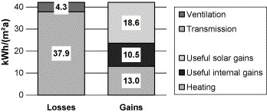
III International Scientific Conference on “Sustainable and Efficient Use of Energy, Water and Natural Resources”
Passive house in Arctic climate
Name: Anastasiia Elnikova
Affiliations: ITMO University
Keywords:
Passive house, energy savings, energy efficiency, Arctic, Low energy building
Definition of Passive House
Passive House is a building standard that is energy efficient,
comfortable and affordable at the same time.
 | Required | Best practice
Heating energy demandª, Q_{h} (kW h/(m²a)) | <15 | ≤10
Primary energy demand^{b}, PE (kW h/(m²a)) | <120 | ≈72
Volume related air leakage at 50 Pa, n₅₀ (h⁻¹) | <0.6 | ≤0.2
Thermal transmittance
U(W h/(m²K) <0.15
Fig. 1. Heat losses and gains in a typical Passive Houses. The losses are almost equally covered by solar gains, internal gains and the heating system.
Fig.2 Passive house criteria. [2]

Slide 5
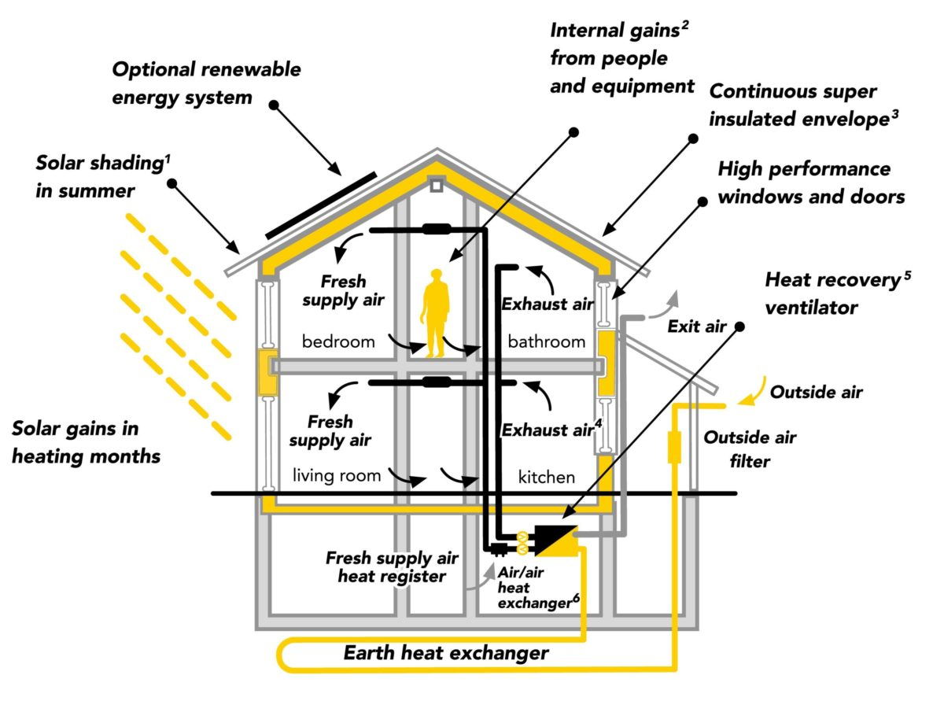
III International Scientific Conference on “Sustainable and Efficient Use of Energy, Water and Natural Resources”
Passive house in Arctic climate
Name:
Anastasiia Elnikova
Keywords:
Passive house, energy savings, energy efficiency, Arctic, Low energy building
Technologies
1. Thermal insulation;
2. Avoiding of thermal bridges;
3. Efficient windows;
4. Air tightness;
5. Mechanical ventilation system with highly efficient heat recovery.
Fig.3 Model of Passive house

Slide 6
III International Scientific Conference on “Sustainable and Efficient Use of Energy, Water and Natural Resources”
Passive house in Arctic climate
Name:
Anastasiia Elnikova
Keywords:
Passive house, energy savings, energy efficiency, Arctic, Low energy building
Arctic context
Geographically, the Arctic is defined by the Polar Circle at 66°33’38 Northern latitude. The land above the Polar Circle amounts to 5.6% of Earth’s surface area. The Arctic is represented by the countries of Greenland, the northern parts of Scandinavia, Russia, Canada and Alaska.
The design concepts for a cold climate are:
to minimize energy and source usage,
to avoid disruption of materials and freezing,
to maximize support of community,
to maximize the use of local materials and labor.
simplicity with reliability

Slide 7
III International Scientific Conference on “Sustainable and Efficient Use of Energy, Water and Natural Resources”
Passive house in Arctic climate
Name:
Anastasiia Elnikova
Keywords:
Passive house, energy savings, energy efficiency, Arctic, Low energy building
Arctic context. Barriers and problems in the Arctic.
Building Regulations reflect current (and even past) rather than the future design practices, construction methods and materials.
Building Regulations are often adopted from temperate climates and implemented without a focus on the extreme climatic conditions.
Building Regulations should manage the development in a way which focuses on energy savings.
Energy prices for non-renewable resources are currently very low
Limited material selection and prices are influenced by logistics and availability of material.
A traditional labor pool have not necessary skilled craftsmen. Absence of price competition leads to monopoly and higher prices.
New methods of construction lead to a delay in the building process and are costly. However, hydropower, wind and solar power slowly becomes available to a wider selection of users. [5]

Slide 8
III International Scientific Conference on “Sustainable and Efficient Use of Energy, Water and Natural Resources”
Passive house in Arctic climate
Name:
Anastasiia Elnikova
Keywords:
Passive house, energy savings, energy efficiency, Arctic, Low energy building
Arctic context. Solutions
The building design is based on design heat loss calculated as transmission and ventilation heat loss.
Combined use of thermal, air, vapor, wind and rain barrier and insulation to decrease the heat loss.
A use of an airtight barrier to prevent the exfiltration through the available leakage.
An air barrier to prevent wind must be used and must be vapor permeable to avoid trapping water vapor between the two barriers.
Cold air entering the building through the infiltration or stack effect is at high relative humidity can be propelled by stack effect or wind forces in locations with extreme winds.
Avoid thermal bridges.
Elevated foundation due to the wind and snow drifting and thawing of permafrost. [5]

Slide 9
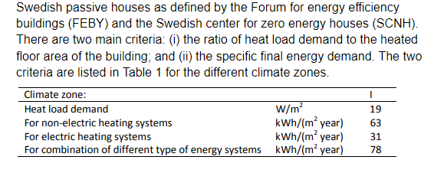
III International Scientific Conference on “Sustainable and Efficient Use of Energy, Water and Natural Resources”
Passive house in Arctic climate
Name:
Anastasiia Elnikova
Keywords:
Passive house, energy savings, energy efficiency, Arctic, Low energy building
Swedish and Finish standards of Passive house
“National Building Code of Finland” regulations for any new building.
U-values : outer walls 0.17 W/(m2K),
ceiling/roof 0.09 W/(m2K),
base floor 0.17 W/(m2K)
windows 1.0 W/(m2K).
airtightness (q50) = 0.8 1/h
Fig. 4 FEBY’12 criteria's of heating for 1 (Arctic ) zone . [4]

Slide 10
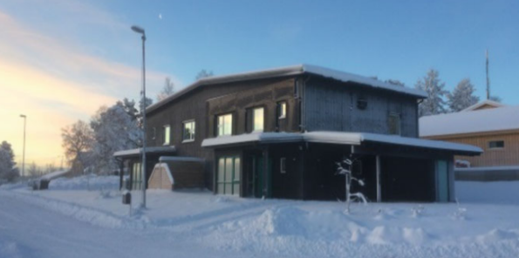
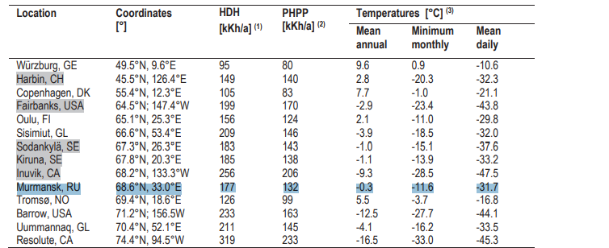
III International Scientific Conference on “Sustainable and Efficient Use of Energy, Water and Natural Resources”
Passive house in Arctic climate
Name:
Anastasiia Elnikova
Keywords:
Passive house, energy savings, energy efficiency, Arctic, Low energy building
Sjunde huset example, Kiruna, Sweden
Fig.5 Climate characteristics of Arctic cities. [5]
Technologies
Values
Estimated specific energy consumption 56.7 kWh/m2 /year (FEBY 63 kWh/m2/year.)
q50 =0.29 (FEBY <0.30 1/h)
HLF 16.3 W/m2
The outer walls have additional rigid polyiso foam (PIR) insulation (0.023 W/m2 K).
The roof is insulated with 1000 mm loose-fill wool insulation.
The foundation slab is insulated with 400 mm graphite foam.
The average thermal transmittance Um < 0.16 W/m2 K (FEBY 0.40 W/m2 K).
Heat exchanger— 83% winter outdoor temperature of −30 °C
Solar panels 15 m2 (500 kWh/year).

Slide 11
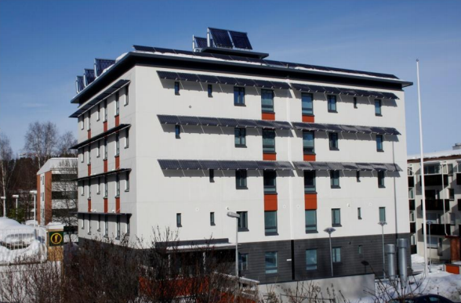
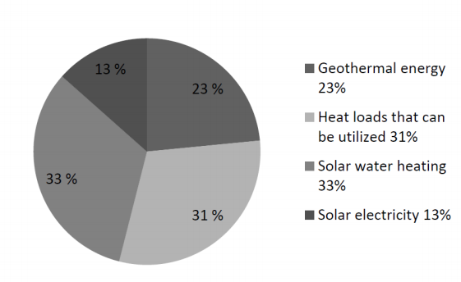
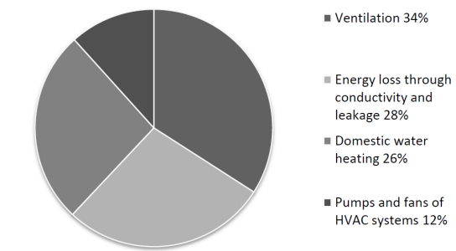
III International Scientific Conference on “Sustainable and Efficient Use of Energy, Water and Natural Resources”
Passive house in Arctic climate
Name:
Anastasiia Elnikova
Keywords:
Passive house, energy savings, energy efficiency, Arctic, Low energy building
Kuopio, Finland
Space heating demand 10.6 KWh/(m2 ∙ a)
73% heat recovery efficiency.
q50-value < 0.4 1/h
U wall = 0.08 W/m2
Fig. 6 Energy consumption and production of Kuopos house

Slide 12
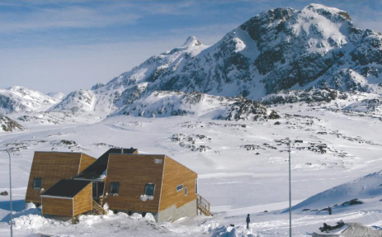
III International Scientific Conference on “Sustainable and Efficient Use of Energy, Water and Natural Resources”
Passive house in Arctic climate
Name:
Anastasiia Elnikova
Keywords:
Passive house, energy savings, energy efficiency, Arctic, Low energy building
Sisimiut example, Greenland
 | Designed | Performed | Standard
Heat energy consumption | 80 kWh/(m2∙a) | 140 kWh/(m2∙a) | 380 kWh/(m2∙a)
U-value windows | 0.8 W/(m2 ·K) | 1.2 W/(m2 ·K) | 1.1 W/(m2 ∙K)
q50 | 0,6 l/s m2 | 2.10 l/s m2 | < 1.5 l/s m2
Fig. 7 Designed and performed values of energy performance.
- The indoor temperature was higher (around 23 C) than assumed during the
design process of the house (21 C).
- The house has not been sufficiently airtight.
- The heat exchanger has in some periods suffered from ice formation.
- Ventilation ducts in the cold attic were insufficiently insulated (originally with
50 mm of insulation).
- Since the living rooms have in periods been quite warm because of solar
gains, the users of the building have opened the terrace door.

Slide 13
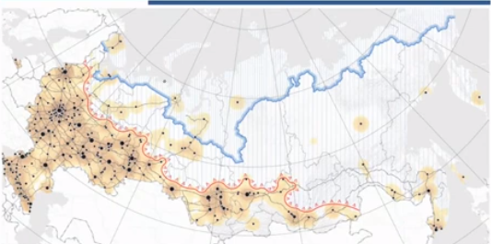
III International Scientific Conference on “Sustainable and Efficient Use of Energy, Water and Natural Resources”
Passive house in Arctic climate
Name:
Anastasiia Elnikova
Keywords:
Passive house, energy savings, energy efficiency, Arctic, Low energy building
Russian context
There is no incentive for developers and their contractors to improve energy efficiency.
monitoring compliance with existing standards have not yet been developed
organizations still do not use these technologies due to the lack of relevant knowledge or qualifications.
But even knowing about these technologies, many craftsman do not change established.
There is no correlation between higher costs and the use of energy efficient technologies.
Fig. 8 Arctic zone in Russia
The energy intensity of heating systems in new multi-apartment buildings in Russia is 77 kWh / m2 / year of thermal energy.
Technologies
Compactness
Ventilated facades
Thermal insulation
Recuperation systems
Flat roofs and simple facades, round houses
Stairwells and kitchens on the windward side

Slide 14
III International Scientific Conference on “Sustainable and Efficient Use of Energy, Water and Natural Resources”
Passive house in Arctic climate
Name: Anastasiia Elnikova
Affiliations: ITMO University
Keywords:
Passive house, energy savings, energy efficiency, Arctic, Low energy building
Results
In theory, it is possible to completely fulfil the fundamental definition of a passive house in the Arctic and therefore to save the cost of traditional heating, but that would incur high costs for the building materials and technical solutions.
The passive house optimization in Arctic should be focused on minimizing the heat loss before maximizing the heat gains.
There should be new building regulations on energy efficiency standards for Arctic regions. However, in some countries there are exemplary standards.
The final energy depend in large extent on the behavior and indoor thermal conditions of the occupants.
New constructive features should be Implemented and new industrial materials developed. One of the feasible methods for wide implementation is to develop and provide typical energy efficient solution for every region.
The payback period of Passive house is around 6-7 years, that means, that it is cost efficient in a long term, taking to the account that in the building stage it costs 10% more than average house. However, studies show that there are no correlation with the costs and energy efficiency of the buildings in general.

Slide 15
III International Scientific Conference on “Sustainable and Efficient Use of Energy, Water and Natural Resources”
Passive house in Arctic climate
Name: Anastasiia Elnikova
Affiliations: ITMO University
Keywords:
Passive house, energy savings, energy efficiency, Arctic, Low energy building
Conclusions
Passive house is an opportunity to improve indoor climate, health and security towards extreme climate for the inhabitants in the Arctic areas.
The passive house should be based on sensible solutions regarding material use and using energy efficient buildings on a practical level.
The house has to be designed carefully, avoiding changes of plans at later stages of the project. There should be monitoring system for the buildings performance also.
References
Vitaly Arkhipov, Energy efficient building in the Arctic, et al 2019 IOP Conf. Ser.: Mater. Sci. Eng. 643 012101. [CrossRef]
Feist, W.; Schnieders, J.; Dorer, V.; Haas, A. Re-inventing air heating: Convenient and comfortable within the frame of the Passive House concept. Energy Build. 2005, 37, 1186–1203. [CrossRef]
Rode, C.; Vladykova, P. ; Kotol, M. Air Tightness and Energy Performance of an Arctic Low-Energy House, Rode et al. 2010. [CrossRef]
Johansson, D., Bagge, H., & Wahlström, Å. (Eds.). (2019). Cold Climate HVAC 2018. Springer Proceedings in Energy. 2018. p. 3-16. [CrossRef]
5.Vladyková, P 2011, An energy efficient building for the Arctic climate: Is a passive house sensible solution for Greenland? DTU Civil Engineering Reports, Technical University of Denmark, Kgs. Lyngby, Denmark. 2011. [CrossRef]
Acknowledgement

Slide 16
III International Scientific Conference on “Sustainable and Efficient Use of Energy, Water and Natural Resources”
Passive house in Arctic climate
Name: Anastasiia Elnikova
Affiliations: ITMO University
Keywords:
Passive house, energy savings, energy efficiency, Arctic, Low energy building
Thank you for your attention!
Author: Anastasiia A. Elnikova
Affiliation: ITMO University, Faculty of Energy and Ecotechnology
Contact details: anastasiaelnikov@gmail.com

