Slide 1





Title: «Using pinch analysis technology to assess energy efficiency in oil refining technology»
III International Scientific Conference “Sustainable and efficient use
of energy, water and natural resources – SEWAN-2021”
Authors: E.A. Yushkova¹, V.A. Lebedev¹, A.A. Nikitin²
Affiliations: ¹Saint Petersburg Mining University, ²National Research University ITMO
St. Petersburg, Russia
Saint-Petersburg, April 19-24, 2021
Notes:
Уважаемые члены совета, вашему вниманию предлагается доклад по диссертационной работе «Анализ энергетической эффективности
систем утилизации теплоты вытяжного воздуха активного типа».
Научным руководителем данной работы является Сулин Александр Борисович.

Slide 2

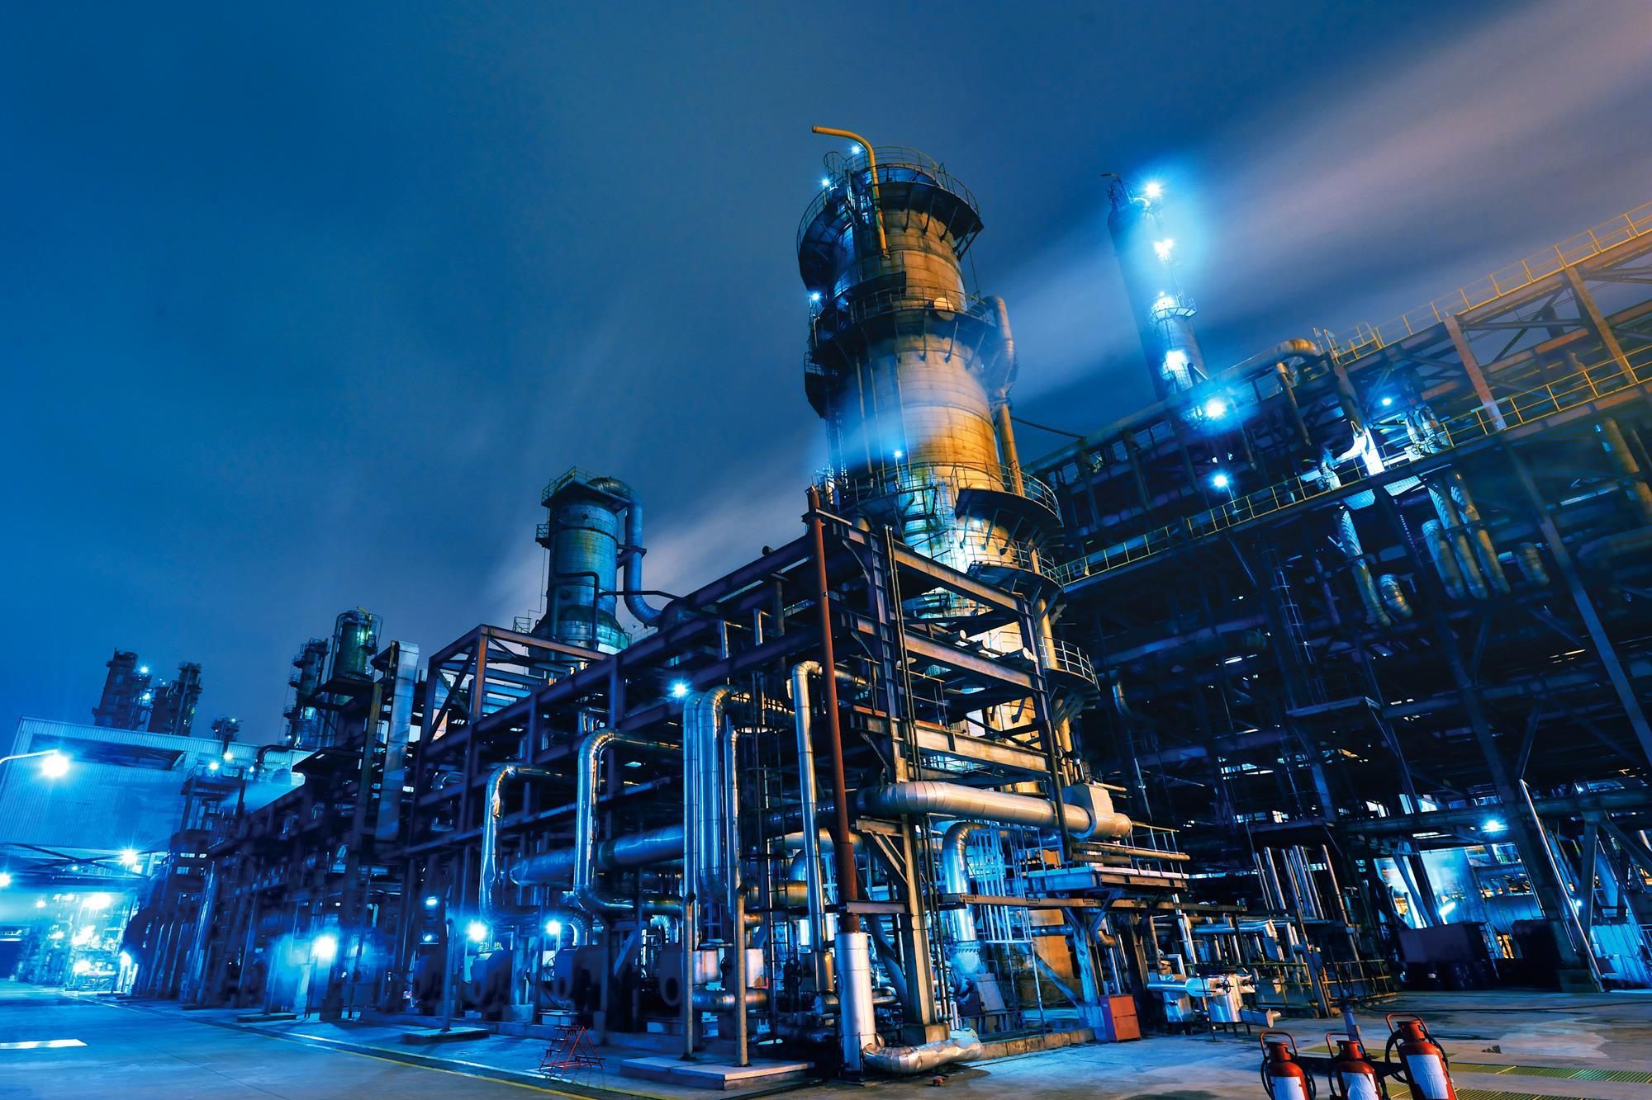
III International Scientific Conference on “Sustainable and Efficient Use of Energy, Water and Natural Resources”
«Using pinch analysis technology to assess energy efficiency in oil refining technology»
Names E.A. Yushkova¹, V.A. Lebedev¹, A.A. Nikitin²
Affiliations ¹Saint Petersburg Mining University, ²National Research University ITMO
Keywords: exergy, increasing energy efficiency, energy, fuel
The fuel and energy complex in Russia consumes a significant part of the energy produced. Improving the energy efficiency of the fuel and energy complex is an important task for the state.
The relevance of research:

Slide 3
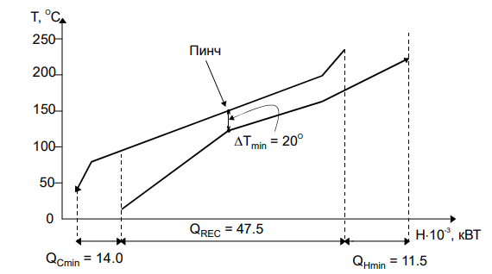
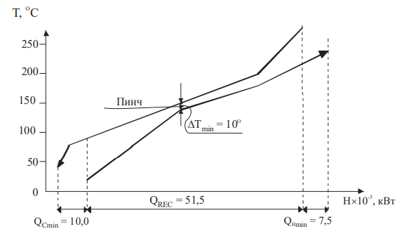
III International Scientific Conference on “Sustainable and Efficient Use of Energy, Water and Natural Resources”
«Using pinch analysis technology to assess energy efficiency in oil refining technology»
Names E.A. Yushkova¹, V.A. Lebedev¹, A.A. Nikitin²
Affiliations ¹Saint Petersburg Mining University, ²National Research University ITMO
Keywords: exergy, increasing energy efficiency, energy, fuel
Pinch analysis is one of the most effective methods for assessing and improving the energy efficiency of heat and mass transfer processes. This method allows for structural and parametric optimization of heat exchange systems. This method is based on the enthalpy approach. Indeed, the enthalpy method is most often used to study power plants for energy efficiency. The enthalpy analysis method does not determine energy from the qualitative point of view.
A more complete and objective assessment of various types of energy allows us to give an exergy approach that takes into account the quality of energy.In connection with the above, it becomes necessary to develop such a method of thermodynamic analysis and improvement of systems (in particular, the oil refining industry), which would combine the advantages of the exergy method and the method of structural and parametric optimization of thermal processes based on Pinch analysis.

Slide 4
III International Scientific Conference on “Sustainable and Efficient Use of Energy, Water and Natural Resources”
«Using pinch analysis technology to assess energy efficiency in oil refining technology»
Names E.A. Yushkova¹, V.A. Lebedev¹, A.A. Nikitin²
Affiliations ¹Saint Petersburg Mining University, ²National Research University ITMO
Keywords: exergy, increasing energy efficiency, energy, fuel
The heat exchange system is optimal when exergy losses tend to be minimal. This expression is represented by the formula:
For this, it is necessary that the recuperation of the exergy of hot and cold streams is maximized, therefore, the difference in the exergy of hot and cold streams tends to a minimum. In most cases, external energy carriers are required for the heat exchange system to function. They, in turn, impose a financial burden on the enterprise. Thus, the sums of exergies of external hot and cold energy carriers (utilities) must be minimized. Taking into account the above, to optimize the heat exchange system, in addition to the convergence of the composite curves to ΔТmin, one should use the formula:

Slide 5
III International Scientific Conference on “Sustainable and Efficient Use of Energy, Water and Natural Resources”
«Using pinch analysis technology to assess energy efficiency in oil refining technology»
Names E.A. Yushkova¹, V.A. Lebedev¹, A.A. Nikitin²
Affiliations ¹Saint Petersburg Mining University, ²National Research University ITMO
Keywords: exergy, increasing energy efficiency, energy, fuel

Slide 6
III International Scientific Conference on “Sustainable and Efficient Use of Energy, Water and Natural Resources”
«Using pinch analysis technology to assess energy efficiency in oil refining technology»
Names E.A. Yushkova¹, V.A. Lebedev¹, A.A. Nikitin²
Affiliations ¹Saint Petersburg Mining University, ²National Research University ITMO
Keywords: exergy, increasing energy efficiency, energy, fuel

Slide 7
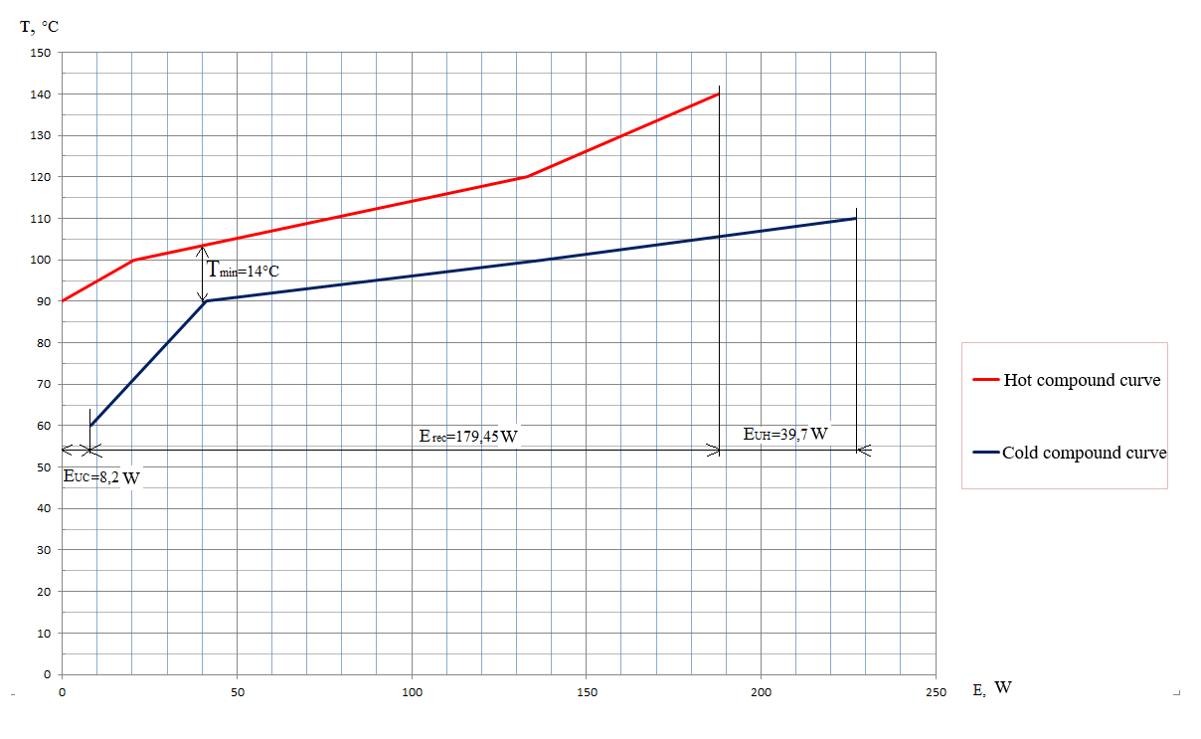
III International Scientific Conference on “Sustainable and Efficient Use of Energy, Water and Natural Resources”
«Using pinch analysis technology to assess energy efficiency in oil refining technology»
Names E.A. Yushkova¹, V.A. Lebedev¹, A.A. Nikitin²
Affiliations ¹Saint Petersburg Mining University, ²National Research University ITMO
Keywords: exergy, increasing energy efficiency, energy, fuel

Slide 8
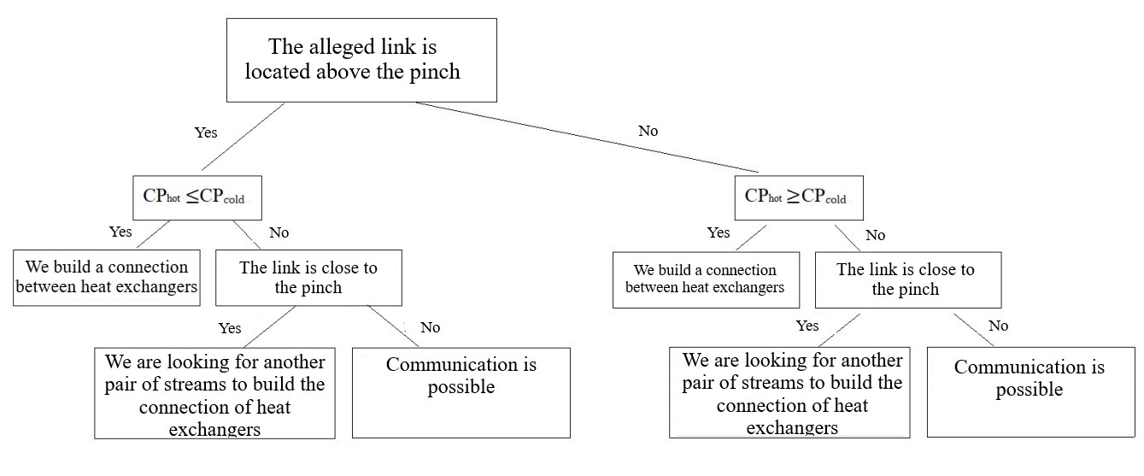
III International Scientific Conference on “Sustainable and Efficient Use of Energy, Water and Natural Resources”
«Using pinch analysis technology to assess energy efficiency in oil refining technology»
Names E.A. Yushkova¹, V.A. Lebedev¹, A.A. Nikitin²
Affiliations ¹Saint Petersburg Mining University, ²National Research University ITMO
Keywords: exergy, increasing energy efficiency, energy, fuel
Algorithm for building a connection between heat exchangers

Slide 9
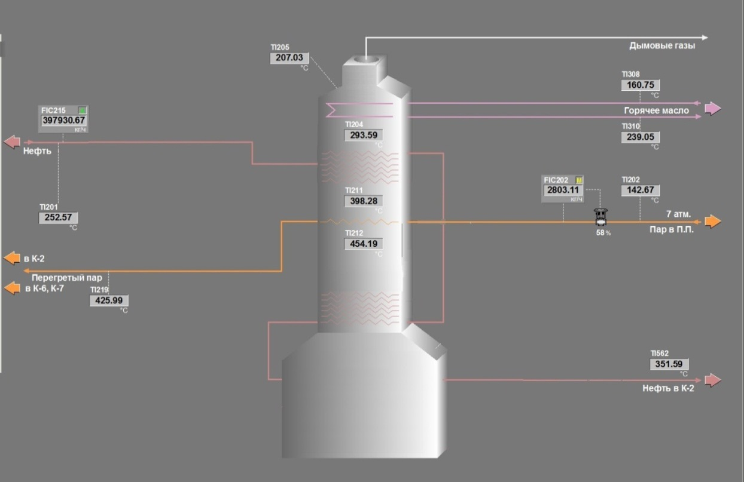
III International Scientific Conference on “Sustainable and Efficient Use of Energy, Water and Natural Resources”
«Using pinch analysis technology to assess energy efficiency in oil refining technology»
Names E.A. Yushkova¹, V.A. Lebedev¹, A.A. Nikitin²
Affiliations ¹Saint Petersburg Mining University, ²National Research University ITMO
Keywords: exergy, increasing energy efficiency, energy, fuel
Object of study furnace of a primary distillation unit

Slide 10
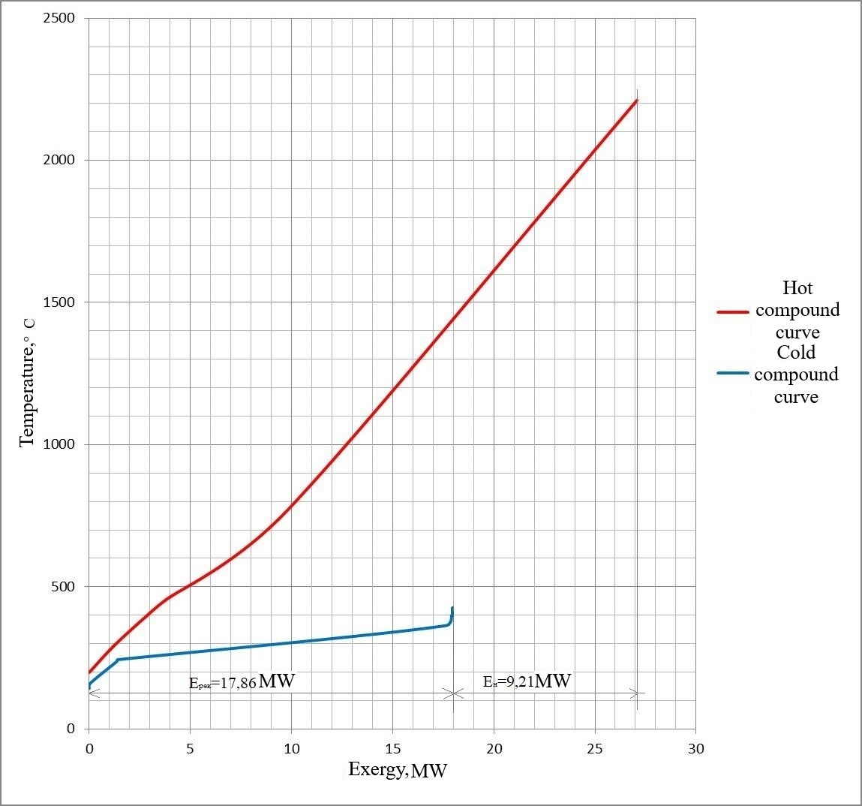
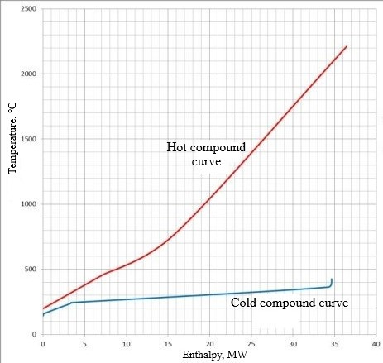
III International Scientific Conference on “Sustainable and Efficient Use of Energy, Water and Natural Resources”
«Using pinch analysis technology to assess energy efficiency in oil refining technology»
Names E.A. Yushkova¹, V.A. Lebedev¹, A.A. Nikitin²
Affiliations ¹Saint Petersburg Mining University, ²National Research University ITMO
Keywords: exergy, increasing energy efficiency, energy, fuel
Converted heat fluxes of the furnace in the "enthalpy - temperature" coordinate system
Converted heat fluxes of the furnace in the "exergy - temperature" coordinate system

Slide 11
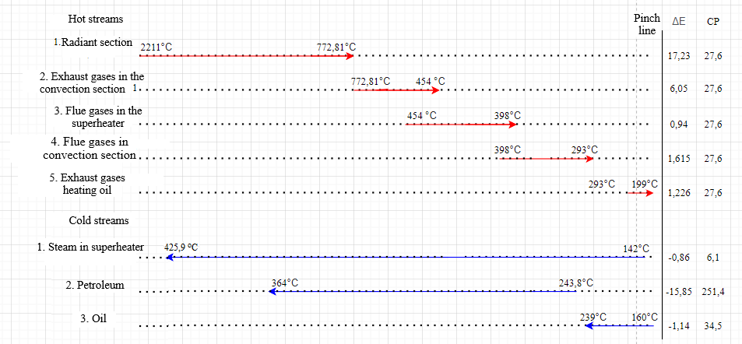
III International Scientific Conference on “Sustainable and Efficient Use of Energy, Water and Natural Resources”
«Using pinch analysis technology to assess energy efficiency in oil refining technology»
Names E.A. Yushkova¹, V.A. Lebedev¹, A.A. Nikitin²
Affiliations ¹Saint Petersburg Mining University, ²National Research University ITMO
Keywords: exergy, increasing energy efficiency, energy, fuel
Hot and cold streams before building heat exchangers

Slide 12
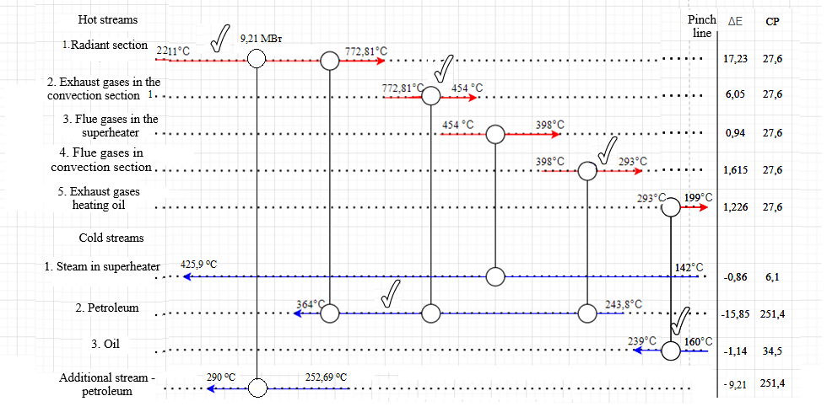
III International Scientific Conference on “Sustainable and Efficient Use of Energy, Water and Natural Resources”
«Using pinch analysis technology to assess energy efficiency in oil refining technology»
Names E.A. Yushkova¹, V.A. Lebedev¹, A.A. Nikitin²
Affiliations ¹Saint Petersburg Mining University, ²National Research University ITMO
Keywords: exergy, increasing energy efficiency, energy, fuel
Results
The final heat exchanger system after optimization

Slide 13
III International Scientific Conference on “Sustainable and Efficient Use of Energy, Water and Natural Resources”
«Using pinch analysis technology to assess energy efficiency in oil refining technology»
Names E.A. Yushkova¹, V.A. Lebedev¹, A.A. Nikitin²
Affiliations ¹Saint Petersburg Mining University, ²National Research University ITMO
Keywords:
keywords
Conclusions
Thus, in the course of this study, we achieved that the loss of exergy became minimal. To rationally use the remaining exergy, we will bring another heat exchanger to hot stream 1, connecting it with an additional oil flow, thereby reducing the losses of the entire primary oil refining unit ELOU AT-6 to zero.
References
1. Lebedev, V.A. Exergy pinch analysis of a furnace in a primary oil refining unit / V.A. Lebedev, E.A. Yushkova, I.S. Churkin // E3S Web of Conferences (TPACEE 2019) - 2019. - Vol. 124. - pp 00001 doi.org/10.1051/e3sconf/202016402011
2. Agapov, D.S. The concept of thermodynamic improvement of power plants. / D. S. Agapov // Izvestia SPbGAU, 2011 - No. 23. - S. 367–371.
3. Brodyansky, V.M. Exergetic method and its applications / V.M. Brodyansky, V. Fratscher, K. Mikhalek; Ed. V.M. Brodyansky. - M .: Energoatomizdat, 1988 .-- 288 p.
4. Brodyansky, V.M. Energy: a quality problem. / V.M. Brodyansky // Journal "Science and Life", 1982. - №3. - S. 88–95.
5. Shargut J., Petela R. Exergy. - M .: Energy. - 1968 .-- 280 s.
6. Patent for invention No. 2702701 Russian Federation. IPC G01K 17/08, F24D 10/00. Device for measuring the exergy of the working environment: No. 201910532: Appl. 11/26/2018: publ. 09/10/2019 / Yushkova E.A., Lebedev V.A.// applicant and patentee of the federal state budgetary educational institution of higher education "St. Petersburg Mining University". - 11 p.
7. Bogdanov, AB Economics of energy with the use of exergy and energy / AB. Bogdanov, O.A. Bogdanov // NIGRE. - 2015. –T.XI (18). - S. 41-53 - URL: http://exergy.narod.ru/Nigre2015-11.PDF (date of access: 11.12.2018). etc
Acknowledgement

Slide 14
III International Scientific Conference on “Sustainable and Efficient Use of Energy, Water and Natural Resources”
«Using pinch analysis technology to assess energy efficiency in oil refining technology»
Names E.A. Yushkova¹, V.A. Lebedev¹, A.A. Nikitin²
Affiliations ¹Saint Petersburg Mining University, ²National Research University ITMO
Keywords:
keywords
Thank you for your attention!
Authors: E.A. Yushkova¹, V.A. Lebedev¹, A.A. Nikitin²
Affiliations: ¹Saint Petersburg Mining University, ²National Research University ITMO
Contact details: atenoks@mail.ru, +79817126350

