Slide 1
Title: Modeling of tailing dumps dusting at different wind speeds
III International Scientific Conference “Sustainable and efficient use of energy, water and natural resources – SEWAN-2021”
Authors: A.A. Cherentsova, L. P. Maiorova, L.T. Krupskaya, M.Yu. Filatova
Affiliations: Pacific National University, Far East Forestry Research Institute, Khabarovsk, 680030, Russia
Saint-Petersburg, April 19-24, 2021
Notes:
Уважаемые члены совета, вашему вниманию предлагается доклад по диссертационной работе «Анализ энергетической эффективности систем утилизации теплоты вытяжного воздуха активного типа».
Научным руководителем данной работы является Сулин Александр Борисович.

Slide 2
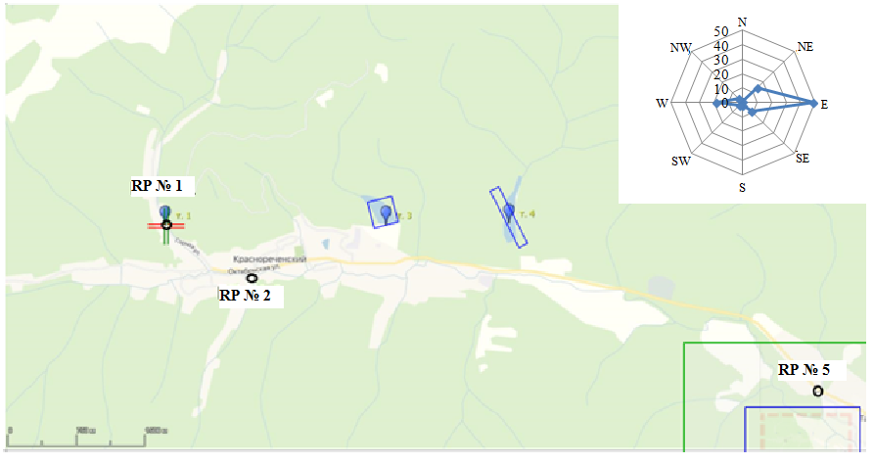
III International Scientific Conference on “Sustainable and Efficient Use of Energy, Water and Natural Resources”
Title Modeling of tailing dumps dusting at different wind speeds
Names A.A. Cherentsova, L. P. Maiorova, L.T. Krupskaya, M.Yu. Filatova
Affiliations Pacific National University, Far East Forestry Research Institute, Khabarovsk, 680030, Russia
Keywords:
keywords
Research Objective:
The aim of this work is the assessment of impact on atmospheric air Krasnorechensky tailing dump in the Primorsky Krai.
Modeling was performed for Krasnorechensky (old and new) tailing dumps for warm period of the year by the variants:
1. Using emission values calculated at wind speed not exceeded in 95 % of cases (U*);
2. At an average annual wind speed;
3. With material moisture content: 0-0.5; up to 1; up to 3; up to 5; up to 7;up to 8; up to 9; up to 10; > 10 %.
б)
Calculation of tailing dumps dusting was performed according to the methodical guide for calculation of fugitive source emissions in the building materials industry (2000).
To calculate the ground level concentrations, the program UPAPE (Unified Program of air pollution estimation) Ecolog - 4.6 was used according to MPEE-2017 (Methods of pollutants emission estimation).
Krasnorechensky tailing dump block

Slide 3
III International Scientific Conference on “Sustainable and Efficient Use of Energy, Water and Natural Resources”
Title Modeling of tailing dumps dusting at different wind speeds Modeling of tailing dumps dusting at different wind speeds
Names A.A. Cherentsova, L. P. Maiorova, L.T. Krupskaya, M.Yu. Filatova
Affiliations Pacific National University, Far East Forestry Research Institute, Khabarovsk, 680030, Russia
Keywords:
keywords
Results
The geochemical series of surface concentrations in the atmosphere (mg/m³) within the limits of the tailing dump impact for compounds of heavy metals and arsenic are as follows (Krasnorechensky settlement residential zone): Pb > Mn > As > Zn > Cu, Sn > Cr > Ni > Co > Mo > Hg.
At the residential area of the Krasnorechensky site, it was revealed that the hygienic requirements were exceeded: for manganese compounds - in 1.07-3.3 times (when the wind speed does not exceed in 95% of cases, the humidity of the material - from 0-0.5% to 8%), for lead compounds - in 2.35-34.54 times and for inorganic dust - in 2.56-38.16 times (when the wind speed does not exceed in 95% of cases, humidity - from 0-0.5 % to 10 %).

Slide 4
III International Scientific Conference on “Sustainable and Efficient Use of Energy, Water and Natural Resources”
Title Modeling of tailing dumps dusting at different wind speeds
Names A.A. Cherentsova, L. P. Maiorova, L.T. Krupskaya, M.Yu. Filatova
Affiliations Pacific National University, Far East Forestry Research Institute, Khabarovsk, 680030, Russia
Keywords:
keywords
Conclusions
The results of the study indicate that dusting of tailings dump contributes significantly to pollution of the environment. Zones of increased technogenic pollution of the air basin and the environment in general are formed, halos of intensive pollution appear in the area of the tailings dump and at considerable distances from them, which causes deterioration of the health of mining settlements population, especially in the areas adjacent to the tailings dumps.
References
Assessment results obtained dust formation of man-made waste stored at the Krasnorechensky tailing dump (Primorsky Territory) is necessary for the development of scientific recommendations to prevent the danger of environmental situations not only in the Far Eastern Federal District, but also in other mining regions of Russia.
Acknowledgement

Slide 5
III International Scientific Conference on “Sustainable and Efficient Use of Energy, Water and Natural Resources”
Title Modeling of tailing dumps dusting at different wind speeds
Names A.A. Cherentsova, L. P. Maiorova, L.T. Krupskaya, M.Yu. Filatova
Affilations Pacific National University, Far East Forestry Research Institute, Khabarovsk, 680030, Russia
Keywords:
keywords
Thank you for your attention!
Authors: A.A. Cherentsova, L. P. Maiorova, L.T. Krupskaya, M.Yu. Filatova
Affiliations:Pacific National University, Far East Forestry Research Institute, Khabarovsk, 680030, Russia
Contact details: e-mail: 000318@pnu.edu.ru

