Slide 1
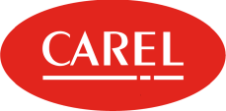
Title: Reorganization of industrial territories in the context of urban development
III International Scientific Conference “Sustainable and efficient use of energy, water and natural resources – SEWAN-2021”
Authors: Eugenia Taubert, Anastasia Pavlova
Affiliations: Faculty of Biotechnologies (BioTech), ITMO University, Russia
Saint-Petersburg, April 19-24, 2021
Notes:
Уважаемые члены совета, вашему вниманию предлагается доклад по диссертационной работе «Анализ энергетической эффективности систем утилизации теплоты вытяжного воздуха активного типа».
Научным руководителем данной работы является Сулин Александр Борисович.

Slide 2
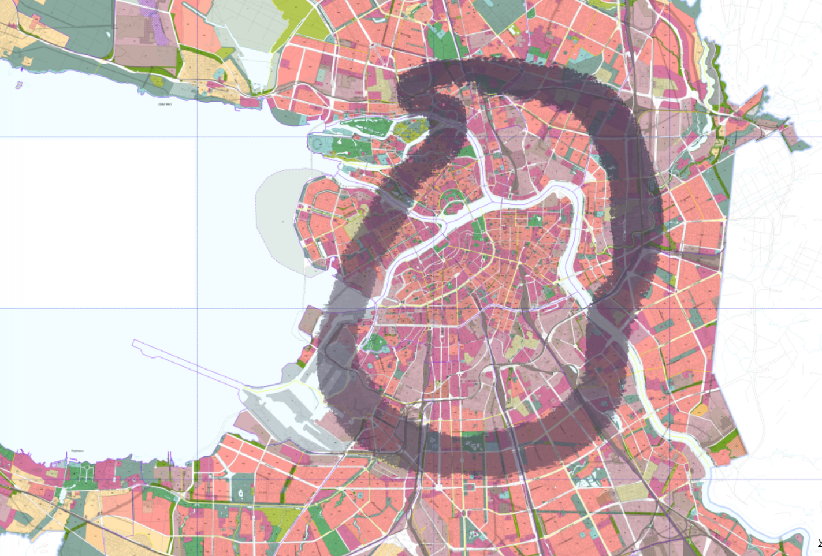
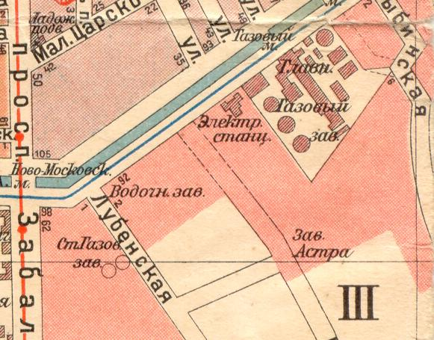
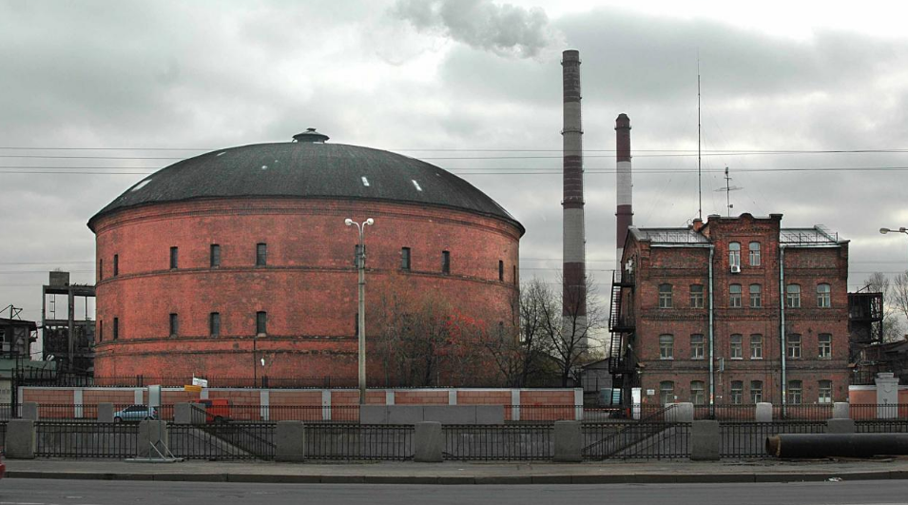
III International Scientific Conference on “Sustainable and Efficient Use of Energy, Water and Natural Resources”
Title: Reorganization of industrial territories in the context of urban development
Names: Eugenia Taubert, Anastasia Pavlova
Affiliations: Faculty of Biotechnologies (BioTech), ITMO University, Russia
Keywords: reorganization of industrial areas, roof greening, sustainable development of the city, BREEAM
The aim of the work is to propose a project for the reorganization of an industrial area included in the “gray belt” territory into a public urban “green” zone, within the framework of obtaining the BREEAM In-Use environmental certification.
Object of investigation:
the main gas-holder of the "Society of Capital Lighting", Obvodnogo Kanala Embankment 74, St. Petersburg.

Slide 3
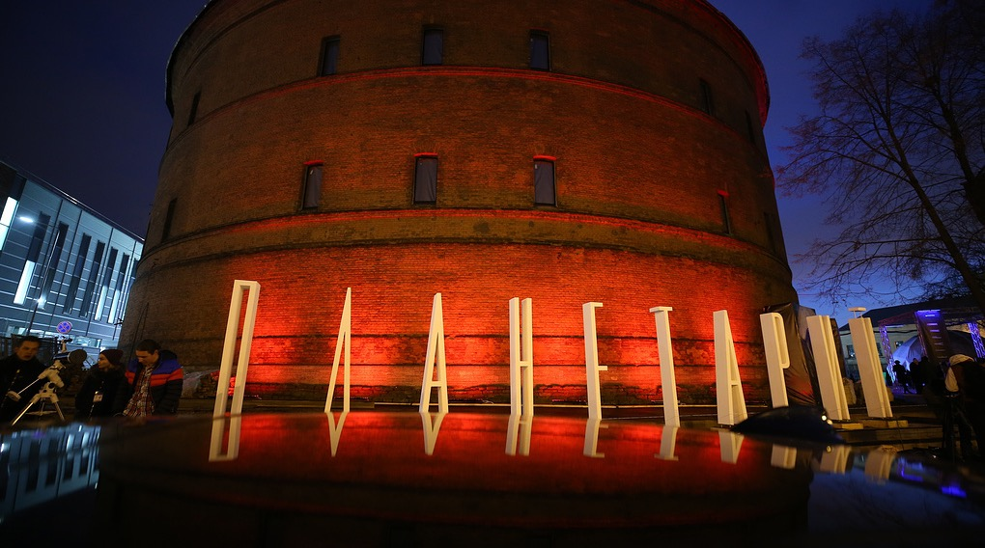
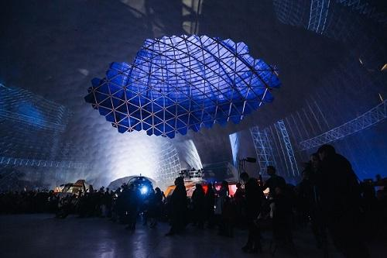
III International Scientific Conference on “Sustainable and Efficient Use of Energy, Water and Natural Resources”
Title: Reorganization of industrial territories in the context of urban development
Names: Eugenia Taubert, Anastasia Pavlova
Affiliations: Faculty of Biotechnologies (BioTech), ITMO University, Russia
Keywords: reorganization of industrial areas, roof greening, sustainable development of the city, BREEAM

Slide 4
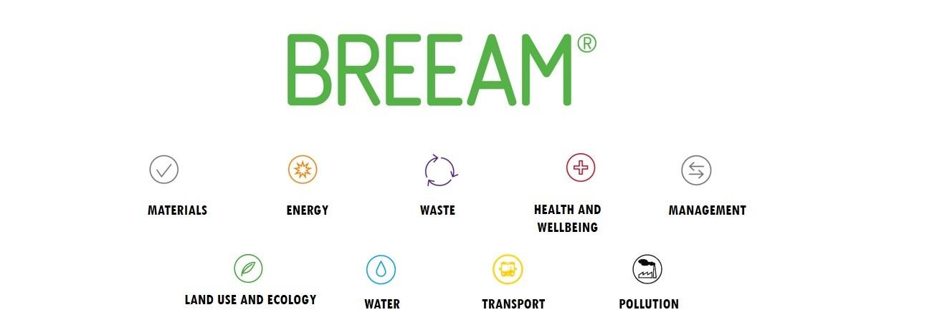
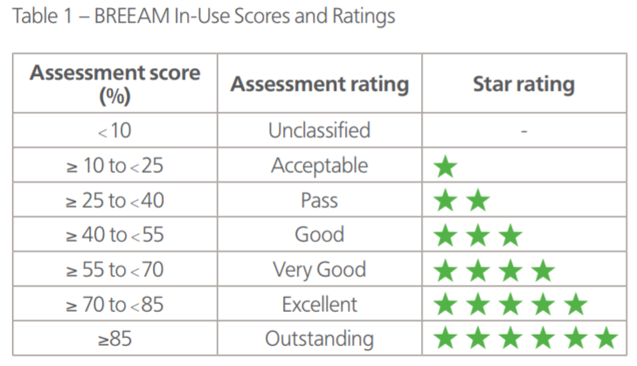
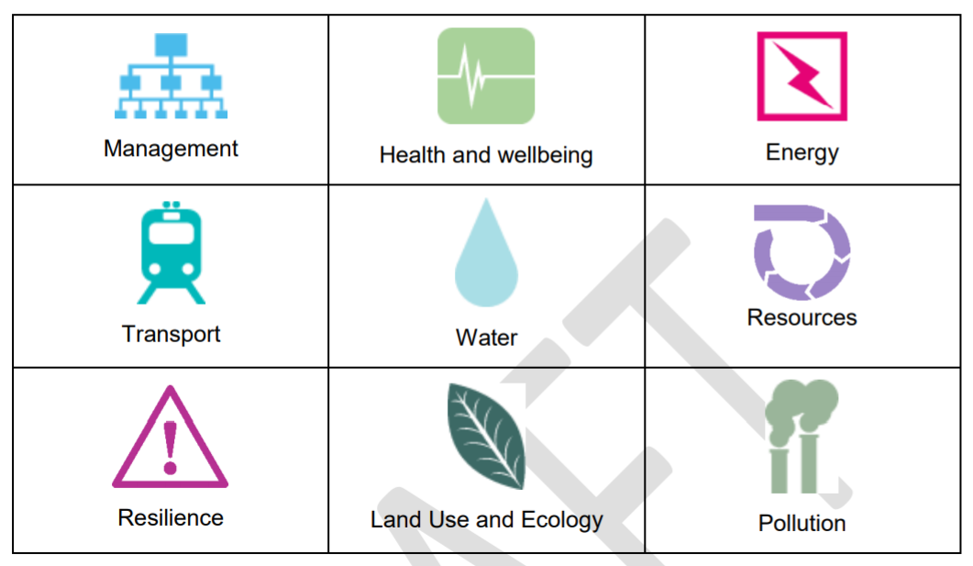
III International Scientific Conference on “Sustainable and Efficient Use of Energy, Water and Natural Resources”
Title: Reorganization of industrial territories in the context of urban development
Names: Eugenia Taubert, Anastasia Pavlova
Affiliations: Faculty of Biotechnologies (BioTech), ITMO University, Russia
Keywords: reorganization of industrial areas, roof greening, sustainable development of the city, BREEAM
Benefits of BREEAM certification for the owner of Planetarium No. 1
Reduced energy, heating and water costs;
Reduce building maintenance costs by optimizing all internal systems;
Attracting potential investors and international partners due to the confirmed certification results;
Higher demand for rental space.
2020 version

Slide 5
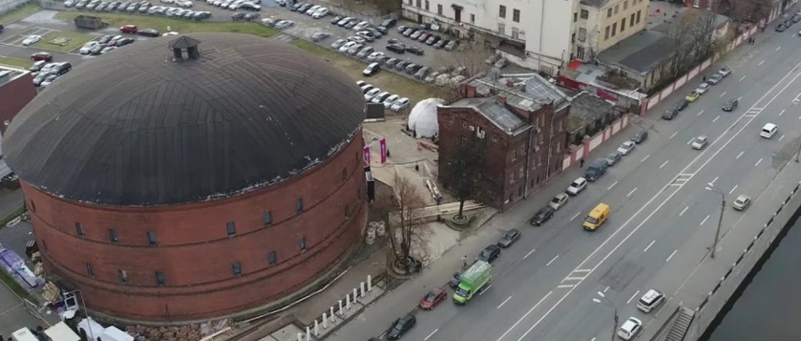
III International Scientific Conference on “Sustainable and Efficient Use of Energy, Water and Natural Resources”
Title: Reorganization of industrial territories in the context of urban development
Names: Eugenia Taubert, Anastasia Pavlova
Affiliations: Faculty of Biotechnologies (BioTech), ITMO University, Russia
Keywords: reorganization of industrial areas, roof greening, sustainable development of the city, BREEAM
The weak point of the Planetarium №1 building has slight thermal insulation of the outer overlays, which is a consequence of the significant energy consumption for heating and cooling the premises. At the same time, the procedure for significant structure modifications of the building is difficult, since it is an object of federal cultural heritage.
additional thermal insulation of the building and electricity costs decrease;
protection of the roof from the destructive effects of the urban environment;
reducing the load on storm sewers;
aesthetically pleasing, due to the vegetation layer being selected not only based on resistance to the climate of St. Petersburg and growing conditions on the roof, but also on flowering throughout the spring and summer seasons;
collecting and filtering storm and melt water for technical needs;
fulfillment of the criteria (in a varying degree) of certification in 7 out of 9 directions;
compensatory greening of urban space and foundation of recreational zone;
attracting investors and additional advertising (important point for commercial projects).
The advantages of roof greening Planetarium №1

Slide 6
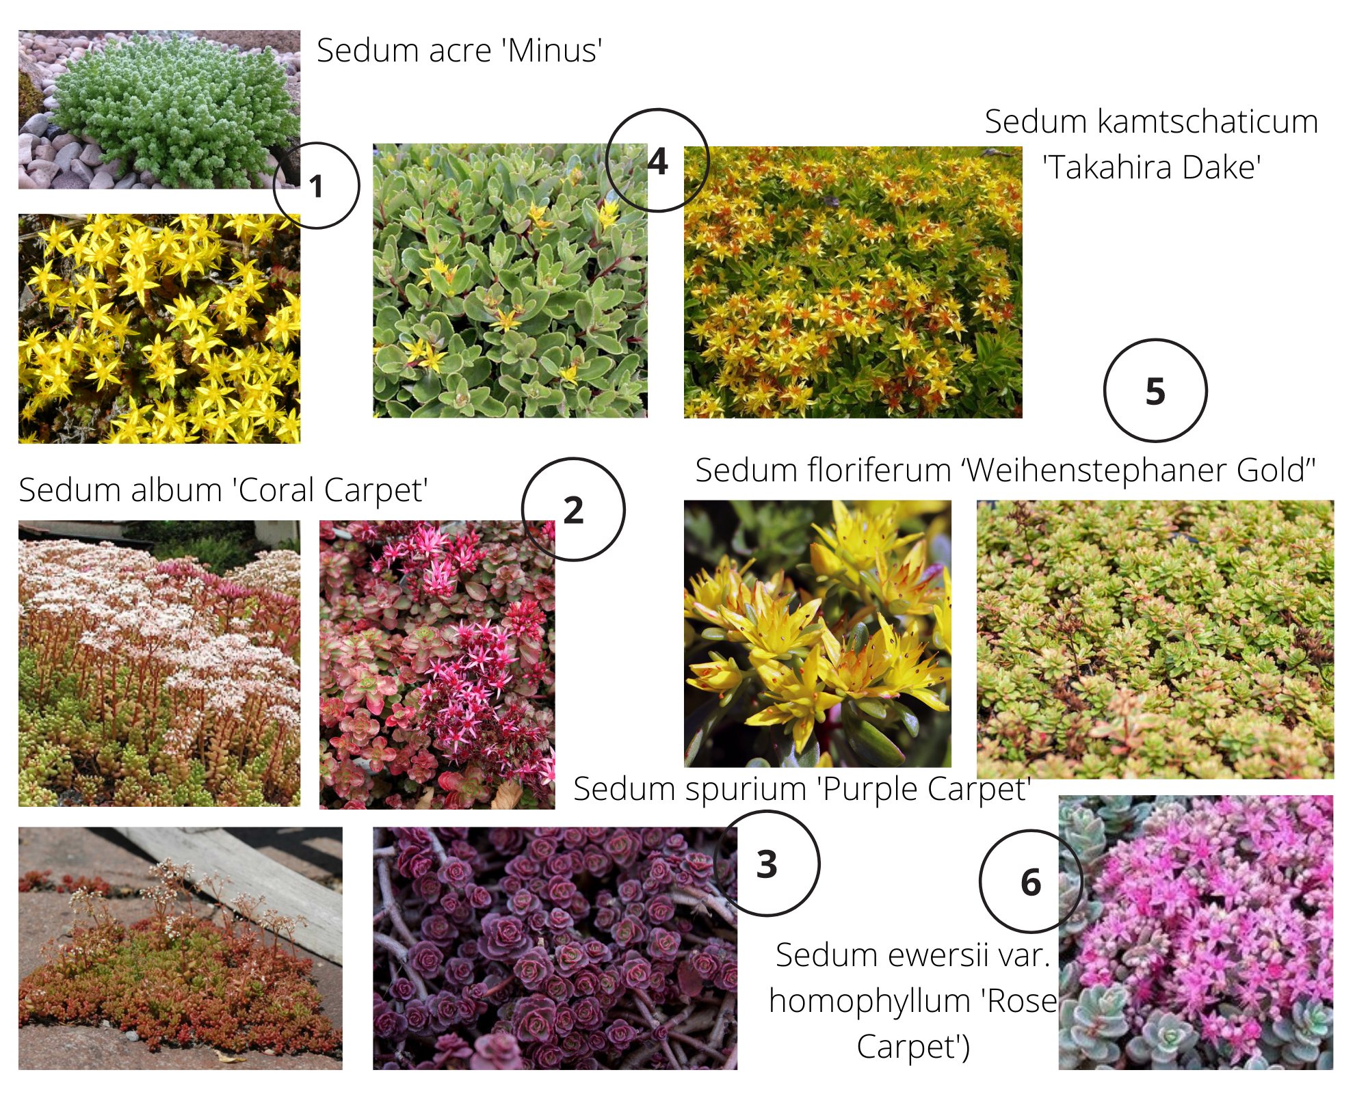
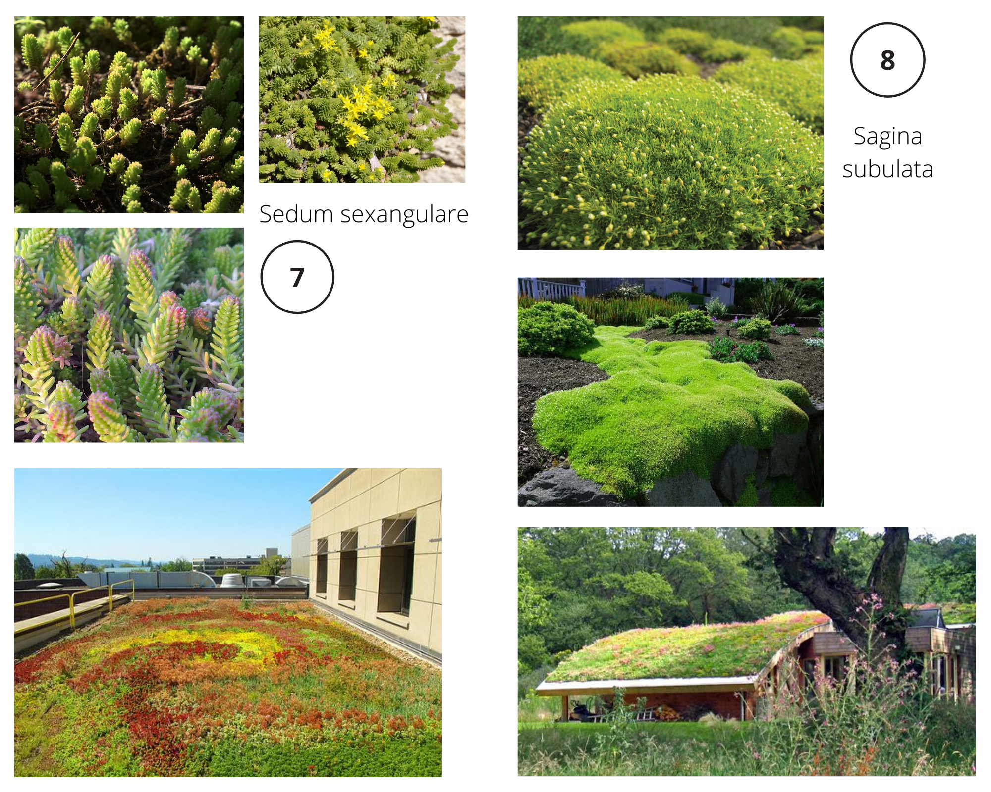
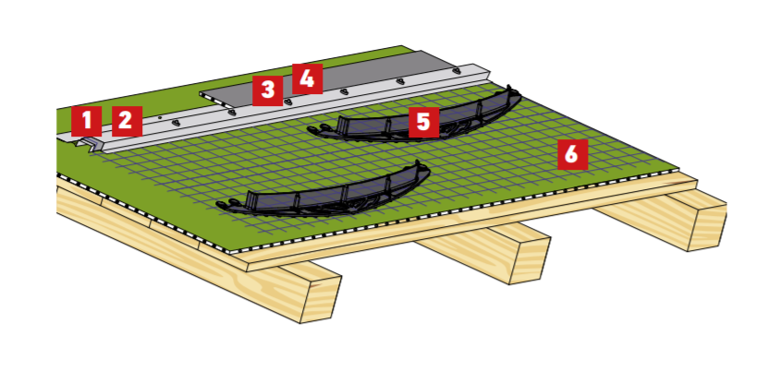
III International Scientific Conference on “Sustainable and Efficient Use of Energy, Water and Natural Resources”
Title: Reorganization of industrial territories in the context of urban development
Names: Eugenia Taubert, Anastasia Pavlova
Affiliations: Faculty of Biotechnologies (BioTech), ITMO University, Russia
Keywords: reorganization of industrial areas, roof greening, sustainable development of the city, BREEAM
Extensive greening roof - a roof created for using a layer of substrate and planting material that has signs of natural plant communities (the ability to self-support, self-renewal and long-term sustainable development), without the possibility of access for visitors, in addition to service personnel (p. 3.27, GOST R 58875-2020).
Building diameter = 42 m²
Building height = 29 m
assortment of landscaping vegetation
1. Mechanical fastening to the base;
2. Screw with support for fixing the profile;
3. Starting fastening profile;
4. Protective strips for sealing the attachment points;
5. System of thresholds for keeping the substrate from shift;
6. Net for fastening anti-shear thresholds
Anti-slip system for extensive greening of pitched roofs with a slope of more than 20 degrees and domed roofs
Roof surface load =
100 kg/m²

Slide 7
III International Scientific Conference on “Sustainable and Efficient Use of Energy, Water and Natural Resources”
Title: Reorganization of industrial territories in the context of urban development
Names: Eugenia Taubert, Anastasia Pavlova
Affiliations: Faculty of Biotechnologies (BioTech), ITMO University, Russia
Keywords: reorganization of industrial areas, roof greening, sustainable development of the city, BREEAM
Results
Conclusions
The calculation by mythology and data from RSS 58875-2020 “Recommendations for ensuring the energy efficiency of residential and public buildings”and CL 50.13330.2012 “Thermal performance of the buildings” showed that roof greening of the gas-holder would reduce the annual heat loss of the building by 20.65%
Roof greening of the gas-holder will allow to:
Fulfillment a number of BREEAM In-Use V6.0 (2020 version) criteria;
Increase the value of the object for the urban environment as an additional recreation area (ecological and social benefits);
Attract potential investors and partners of the international level;
Extend the life of the roof (replacement of waterproofing and adjoining layers);
Roof greening not a closed one private territory, but an accessible cultural and educational zone.
Health and Wellbeing
Energy
Water
Resources
Resilience
Land use and Ecology
Economic
benefits

Slide 8
III International Scientific Conference on “Sustainable and Efficient Use of Energy, Water and Natural Resources”
Title: Reorganization of industrial territories in the context of urban development
Names: Eugenia Taubert, Anastasia Pavlova
Affiliations: Faculty of Biotechnologies (BioTech), ITMO University, Russia
Keywords: reorganization of industrial areas, roof greening, sustainable development of the city, BREEAM
References
Passport of industrial zones of St. Petersburg. 5th edition, 2017, 46 p. [Electronic resource]. Access mode: https: //cipit.gov.spb.ru/media/uploads/userfiles/2017/04/13/passport_rus.pdf (date of access: 18.09.2020)
Government of St. Petersburg. Committee for Urban Planning and Architecture. General plan of St. Petersburg [Electronic resource]. Access mode: http://kgainfo.spb.ru/zakon/generalplan/ (date of access: 18.10.2020)
BREEAM International Non-Domestic Refurbishment 2015. Non-domestic buildings. Technical manual. SD225 1.2 [Electronic resource]. Access mode: https://www.breeam.com/internationalRFO2015/content/resources/output/rfrb_pdf_screen/sd225_rfo_int_2015_scr.pdf (date accessed: 10.10.2020)
Russian State Standard 58875-2020 “Landscaped and maintained roofs of buildings and structures. Technical and environmental requirements". Date of introduction 09/27/2020 [Electronic resource]. Access mode: http://docs.cntd.ru/document/1200173462 (date of access: 05.11.2020)
Regional methodological documents 23-16-2019 St. Petersburg “Recommendations for ensuring the energy efficiency of residential and public buildings” [Electronic resource]. Access mode: http://docs.cntd.ru/document/1200102227 (date accessed: 10.10.2020)
Code of Laws 50.13330.2012 “Thermal performance of the buildings” Date of introduction 07/01/2013 [Electronic resource]. Access mode: http://docs.cntd.ru/document/1200095525 (date accessed: 08.10.2020)
G. M. Badin, S. A. Sychev, G. D. Makaridze. Construction and reconstruction technologies of energy efficient buildings /SPb: BHV-Petersburg, 2017.-464 p.
A.I. Kopylova, A.K. Bogomolova, D.V. Nemova Energy efficiency of a building using green roof technology Construction of Unique Buildings and Structures, 2016, №10 (49). p. 20-34

Slide 9
III International Scientific Conference on “Sustainable and Efficient Use of Energy, Water and Natural Resources”
Title: Reorganization of industrial territories in the context of urban development
Names: Eugenia Taubert, Anastasia Pavlova
Affiliations: Faculty of Biotechnologies (BioTech), ITMO University, Russia
Keywords: reorganization of industrial areas, roof greening, sustainable development of the city, BREEAM
Thank you for your attention!
Authors: Eugenia Taubert, Anastasia Pavlova
Affiliations: Faculty of Biotechnologies (BioTech), ITMO University, Russia
Contact details: taueugen11@gmail.com

