Slide 1
Title: Expansion of the line of recipes for russian bagel products
III International Scientific Conference “Sustainable and efficient use of energy, water and natural resources – SEWAN-2021”
Authors: Tikhiy Anton, Barakova Nadezhda, Sergacheva Elena
Affiliations: ITMO University
Saint-Petersburg, April 19-24, 2021
Notes:
Уважаемые члены совета, вашему вниманию предлагается доклад по диссертационной работе «Анализ энергетической эффективности систем утилизации теплоты вытяжного воздуха активного типа».
Научным руководителем данной работы является Сулин Александр Борисович.

Slide 2
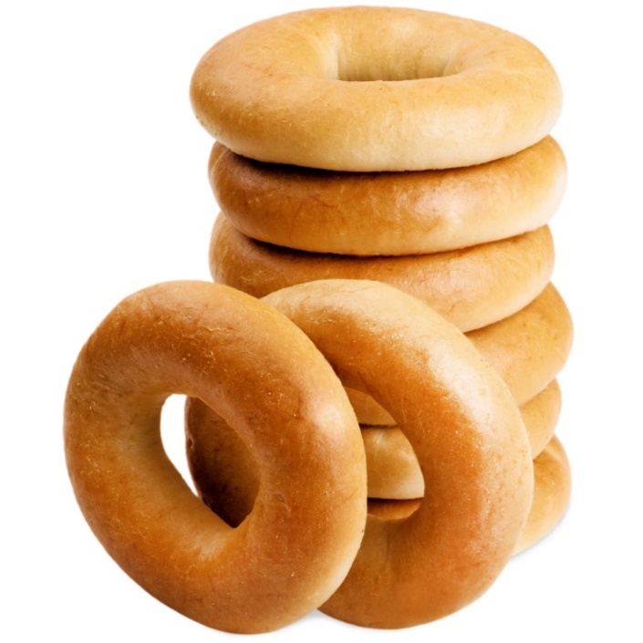
III International Scientific Conference on “Sustainable and Efficient Use of Energy, Water and Natural Resources”
Expansion of the line of recipes for russian bagel products
Tikhiy Anton, Barakova Nadezhda, Sergacheva Elena
ITMO University
Keywords:
Russian bagel, beet, carrot
Research Objective: Increasing the nutritional value of the russian bagels (baranki)
Low nutritional value
Fast stealing speed
Deterioration of taste and odor during storage
Assortment matrix development
pic. Russian bagel (baranki)

Slide 3
III International Scientific Conference on “Sustainable and Efficient Use of Energy, Water and Natural Resources”
Expansion of the line of recipes for russian bagel products
Tikhiy Anton, Barakova Nadezhda, Sergacheva Elena
ITMO University
Keywords:
Russian bagel, beet, carrot
Russian bagels production technology
1. Reception and storage of raw materials
6. Proofing dough pieces
2. Unpacking, sieving bulk ingredients
7. Scald dough pieces
3. Kneading the fermentation dough
8. Baking dough pieces
Vegeteble powder
4. Kneading the dough
9. Cooling
5. Forming and rolling of dough pieces
10. Packaging

Slide 4
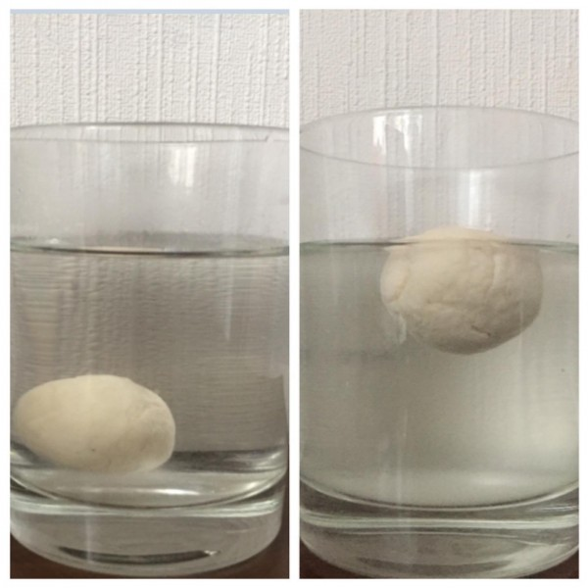
III International Scientific Conference on “Sustainable and Efficient Use of Energy, Water and Natural Resources”
Expansion of the line of recipes for russian bagel products
Tikhiy Anton, Barakova Nadezhda, Sergacheva Elena
ITMO University
Keywords:
Russian bagel, beet, carrot
Methods
Lifting force of yeast in a dough
Two samples were taken from the dough, weighed 5 g each, rolled into a ball, simultaneously dipped into water and time was recorded. Water temperature 30°C. After the balloon ascended, the time was noted.
The average time between two balls was determined as true.
Humidity was determined according to GOST 21094-75
Acidity was determined by GOST 5670-98

Slide 5
III International Scientific Conference on “Sustainable and Efficient Use of Energy, Water and Natural Resources”
Expansion of the line of recipes for russian bagel products
Tikhiy Anton, Barakova Nadezhda, Sergacheva Elena
ITMO University
Keywords:
Russian bagel, beet, carrot
Raw material
Name | Humidity,% | GOST/TU
Wheat floor | No more 15 | GOST 26574-2017
Pressed yeast | No more 73 | GOST 54731-2011
Sugar | No more 0,1 | GOST 33222-2015
Carrot powder | No more 10 | TU BY 391346234.03-2017
Beet powder | No more 10 | TU BY 391346234.03-2017

Slide 6
III International Scientific Conference on “Sustainable and Efficient Use of Energy, Water and Natural Resources”
Expansion of the line of recipes for russian bagel products
Tikhiy Anton, Barakova Nadezhda, Sergacheva Elena
ITMO University
Keywords:
Russian bagel, beet, carrot
Recipe for russian bagels
Name | Fermentation dough |  | Dough
 | Control 0% | Powder 6% | Control 0% | Powder 6%
Fermentation dough, kg |  |  | 30,4 | 30,4
Wheat flour, kg | 20,0 | 20,0 | 80,0 | 80,0
Sunflower oil, kg |  |  | 8,0 | 8,0
Pressed yeast, kg | 0,5 | 0,5
Sugar, kg |  |  | 9,0 | 9,0
Salt, kg |  |  | 1,5 | 1,5
Vegetable powder(6%), kg |  | 1,2 |  | 6,0
Water, kg | 10,0 | 11,0 | 28,5 | 30,0
TOTAL | 30,4 | 32,6 | 157,4 | 164,9
Humidity, % | 41,0 |  | 31,0

Slide 7
III International Scientific Conference on “Sustainable and Efficient Use of Energy, Water and Natural Resources”
Expansion of the line of recipes for russian bagel products
Tikhiy Anton, Barakova Nadezhda, Sergacheva Elena
ITMO University
Keywords:
Russian bagel, beet, carrot
The results of adding carrot powder to the fermentation dough

Slide 8
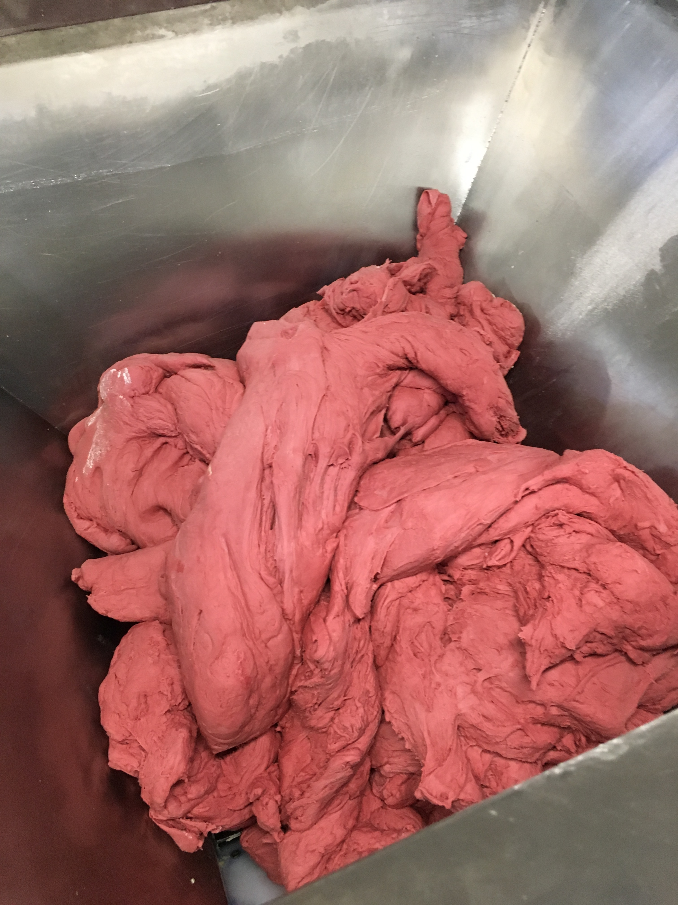
III International Scientific Conference on “Sustainable and Efficient Use of Energy, Water and Natural Resources”
Expansion of the line of recipes for russian bagel products
Tikhiy Anton, Barakova Nadezhda, Sergacheva Elena
ITMO University
Keywords:
Russian bagel, beet, carrot
The results of adding carrot or beet powder to the dough
Adding powders to the dough reduced the fermentation time.
An experiment was carried out to enrich the bagels with 6% beet and 6% carrot powders.
It was found that when adding powders, the moisture absorption capacity of the dough increases.
It was found that when adding powders, the kneading time is reduced.
pic. Dough with beetroot powder

Slide 9
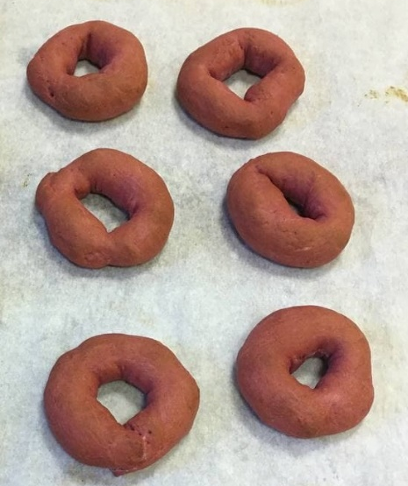
III International Scientific Conference on “Sustainable and Efficient Use of Energy, Water and Natural Resources”
Expansion of the line of recipes for russian bagel products
Tikhiy Anton, Barakova Nadezhda, Sergacheva Elena
ITMO University
Keywords:
Russian bagel, beet, carrot
Conclusions
In terms of organoleptic characteristics, the samples with the addition of powders externally differed from the control sample in shades, in the case of beets - with a pink tint, in the case of carrots - with a yellow cream shade.
In terms of taste, the samples with the powder had a slight increase in sweetness.
References
Add powders in doses from 3% to 6%, with an increase dosage, an improvement in technological modes is observed.
To accelerate the fermentation of the dough, add 50% of the prescription dosage of the powder to the dough.

Slide 10
III International Scientific Conference on “Sustainable and Efficient Use of Energy, Water and Natural Resources”
Expansion of the line of recipes for russian bagel products
Tikhiy Anton, Barakova Nadezhda, Sergacheva Elena
ITMO University
Keywords:
Russian bagel, beet, carrot
Thank you for your attention!
Authors: Tikhiy Anton, Barakova Nadezhda, Sergacheva Elena
Affiliations: ITMO University
Contact details: zik082@rambler.ru

