Slide 1




Total Site Hydrogen Integration and Waste Hydrogen Purification for Minimising Fresh Hydrogen Consumption
Limei Gai*, Petar Sabev Varbanov, Yee Van Fan, Jiří Jaromír Klemeš
Sustainable Process Integration Laboratory – SPIL, NETME Centre, Faculty of Mechanical Engineering, Brno University of Technology - VUT BRNO, Technická 2896/2, 616 69 Brno, Czech Republic
III International Scientific Conference on “Sustainable and Efficient Use of Energy, Water and Natural Resources”, 19-24 April 2021 (Online)

Slide 2
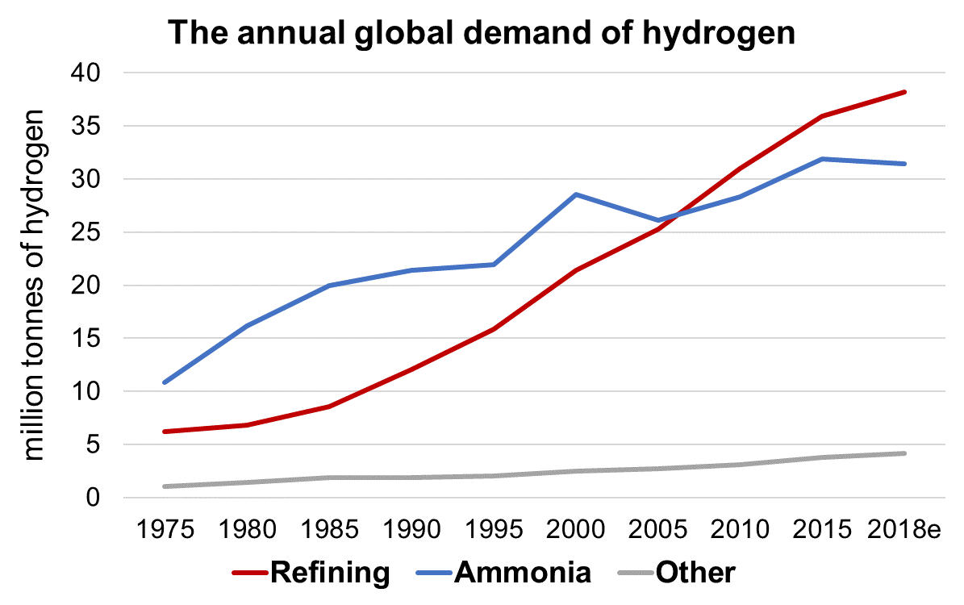
1. Introduction
IEA, 2019, The Future of Hydrogen - Analysis and key findings. A report by the International Energy Agency. < https://www.iea.org/reports/the-future-of-hydrogen >

Slide 3






Problems to be Solved
High-quality Fresh H₂ (FR1)
…
Low-quality Fresh H₂ (FRn)
Plant A
Plant B
Plant C
Interplant H₂ flow 1
…
Interplant H₂ flow 2
Waste H₂
Regenerated H₂ with Purity 1
…
Regenerated H₂ with Purity n
Purification A
Purification B
Purification C
Waste H₂ recovery/ regeneration System
Multiple-resource Total Site Hydrogen Integration with waste hydrogen recovery
Lou Y, Liao Z, Sun J, Jiang B, Wang J, Yang Y. A novel two-step method to design inter-plant hydrogen network. Int J Hydrog Energy 2019;44:5686–95.
Ruan X, Huo W, Wang J, Guo M, Zheng W, Zou Y, et al. Multi-technique integration separation frameworks after steam reforming for coal-based hydrogen generation. Chin J Chem Eng 2020.

Slide 4
Aim and Novelty
Aim:
    Develop an extended Pinch Analysis (PA) to min fresh H₂ consumption and max waste H₂ recovery through Total Site Integration
    Consider various waste H₂ purification options for the regeneration of waste H₂ to further increase waste H₂ recovery
    Novel Contributions:
    Integration and recovery of hydrogen in networks at Process and Total Site context
    Consideration of fresh H₂ sources at different quality levels
    H₂ PA is extended to Total Site scope and multiple fresh resources
    Sustainable waste H₂ recovery design by techno-economic performance

Slide 5
2. Method
Start
1. Data collection and extraction of H₂ source and sink
2. Multiple-resource Pinch Analysis of intra-plant H₂ network
3. Total Site H₂ Integration of inter-plant H₂ network with multiple-resource
Can waste H₂ be purified?
No
Purified H₂
Yes
4. Select and Simulate waste H₂ purification process
5. Optimise the waste H₂ recovery process by techno-economic analysis
6. Compare the old and new H₂ Networks
End
Overall integration procedure of multiple-resource Total Site Hydrogen Integration with waste hydrogen recovery

Slide 6
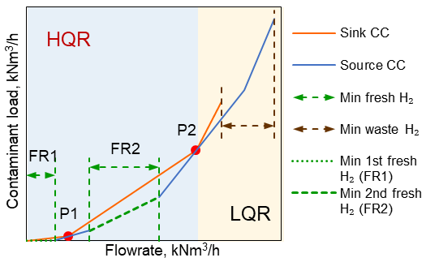
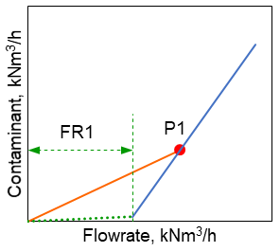
Multiple-Resource Pinch Analysis of intra-Plant H₂ Integration – Plants Alone
The order of utilisation of fresh H₂ sources is FRn (lowest-quality fresh H₂), FRn-1, ..., FR2, FR1 (highest-quality fresh H₂)
The performed order of the Pinch points is FR1, FR2, ..., FRn
Wan Alwi SR, Manan ZA. Targeting Multiple Water Utilities Using Composite Curves. Ind Eng Chem Res 2007;46:5968–76.

Slide 7
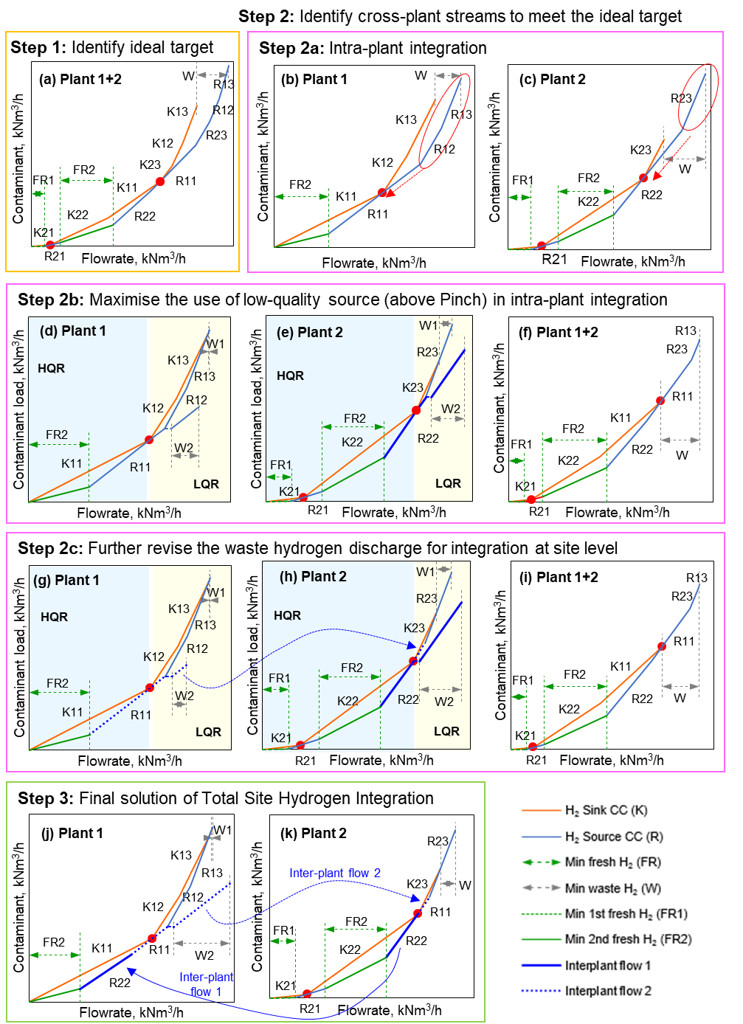
Multiple-resource Pinch Analysis of Total Site H₂ Integration-I

Slide 8
Multiple-resource Pinch Analysis of Total Site H₂ Integration-II

Slide 9
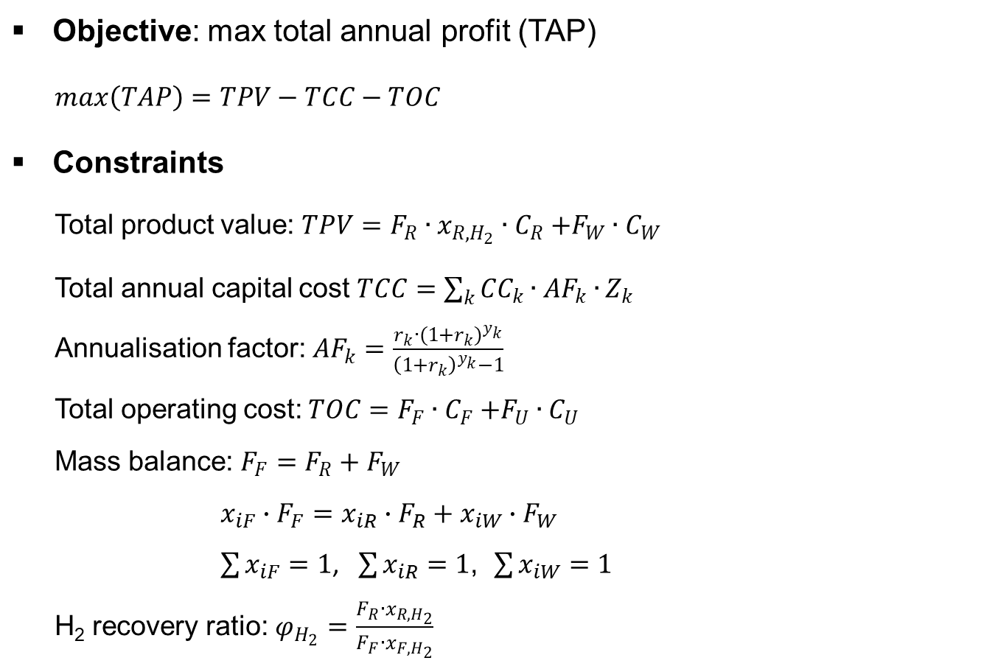
Optimisation of Waste H₂ Purification
Objective: max total annual profit (TAP)
$$max\left(TAP\right)=TPV−TCC−TOC$$
Constraints
Total product value: $TPV=F_{R}{∙x_{R,H_{2}}∙C}_{R}+F_{W}{∙C}_{W}$
Total annual capital cost $TCC=\sum_{k}{{CC}_{k}∙{AF}_{k}∙}Z_{k}$
Annualisation factor: ${AF}_{k}=\frac{r_{k}∙{(1+r_{k})}^{y_{k}}}{{\left(1+r_{k}\right)}^{y_{k}}−1}$
Total operating cost: $TOC=F_{F}{∙C}_{F}+F_{U}{∙C}_{U}$
Mass balance: $F_{F}=F_{R}+F_{W}$
$$x_{iF}∙F_{F}=x_{iR}∙F_{R}+x_{iW}∙F_{W}$$
$\sum{x_{iF}}=1$, $\sum{x_{iR}}=1$, $\sum{x_{iW}}=1$
H₂ recovery ratio: $φ_{H_{2}}=\frac{F_{R}∙x_{R,H_{2}}}{F_{F}∙x_{F,H_{2}}}$

Slide 10
3. Case study
Table 1. Hydrogen sources and sinks of hydrogen network in refineries
H₂ network | H₂ Sources | H₂ concentration, vol% | Flowrate, kNm³/h | H₂ Sinks | H₂ concentration, vol% | Flowrate, kNm³/h
Plant A | SRA1 | 80 | 17.30 | SKA1 | 86.7 | 93.31
 | SRA2 | 80 | 60.68 | SKA2 | 83.6 | 82.66
 | SRA3 | 75 | 55.28 | SKA3 | 82.6 | 39.16
 | SRA4 | 75 | 25.87 | SKA4 | 74.9 | 12.47
 | SRA5 | 70 | 8.00 | SKA5 | 72.7 | 5.73
 | SRA6 | 65 | 3.84
Plant B | SRB1 | 93 | 50.30 | SKB1 | 80.6 | 201.20
 | SRB2 | 80 | 33.53 | SKB2 | 78.9 | 14.53
 | SRB3 | 75 | 145.31 | SKB3 | 77.6 | 44.71
 | SRB4 | 75 | 11.12 | SKB4 | 75.1 | 58.12
 | SRB5 | 73 | 27.94
 | SRB6 | 70 | 36.89
Plant C | SRC1 | 98.3 | 3.23 | SKC1 | 99.9 | 9.68
 | SRC2 | 98.3 | 6.45 | SKC2 | 98.6 | 2.24
 | SRC3 | 97.5 | 6.45 | SKC3 | 97.5 | 11.29
 | SRC4 | 96 | 2.30 | SKC4 | 97 | 8.06
 | SRC5 | 95 | 6.45 | SKC5 | 90 | 12.10
 | SRC6 | 90 | 9.68
 | SRC7 | 85 | 6.05
First fresh H₂ source (FR1-99.9%): fresh H₂ with 99.9 % purity; Second fresh H₂ source (FR2-95%): fresh H₂ with 95 % purity
Lou Y, Liao Z, Sun J, Jiang B, Wang J, Yang Y. A novel two-step method to design inter-plant hydrogen network. Int J Hydrog Energy 2019;44:5686–95.

Slide 11
Separation and Purification of Waste H₂
Table 2. Comparison of waste H₂ recovery technology in a refinery
Projects | Cryogenic | PSA | Membrane
Purity of recovered H₂, mol% | 90-96 | > 99 | 90-98
Recycling ratio, % | 90-98 | 50-92 | 85-95
Feed H₂ concentration, mol% | 15-75 | 75-90 | 15-90
Feed gas pressure, MPa | 0.5-7.5 | 1-4 | 1-16
Product H₂ pressure, MPa | Feed pressure | Feed pressure | << Feed pressure
Pretreatment requirement | Very few | None | Remove CO₂, H₂S, etc
Capital cost | High | Medium | Low
Degree of easy expansion | Low | Medium | High
Operational reliability | Low | Medium | High
Equipment floor space | High | Medium | Low
Elsherif M, Manan ZA, Kamsah MZ. State-of-the-art of hydrogen management in refinery and industrial process plants. Journal of Natural Gas Science and Engineering. 2015;24:346-56.

Slide 12

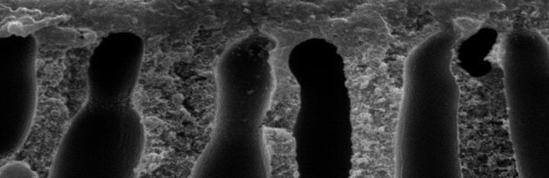
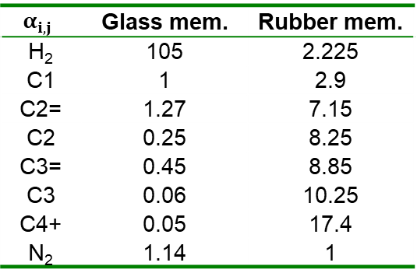
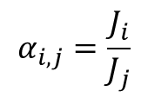
    Membrane Selection and Key Parameters
      Membrane separation performance
      Membrane separation coefficient: the ratio of two gases permeability rates
$$α_{i,j}$$ | Glass mem. | Rubber mem.
H₂ | 105 | 2.225
C1 | 1 | 2.9
C2= | 1.27 | 7.15
C2 | 0.25 | 8.25
C3= | 0.45 | 8.85
C3 | 0.06 | 10.25
C4+ | 0.05 | 17.4
N₂ | 1.14 | 1
$$α_{i,j}=\frac{J_{i}}{J_{j}}$$
Organic porous mem.
Organic non-porous mem. (Molecular states)
Glass mem.
Rubber mem.
Screening principle
High separation efficiency, complex principle
Ruan X, Xiao H, Jiang X, Yan X, Dai Y, He G. Graphic synthesis method for multi-technique integration separation sequences of multi-input refinery gases. Sep Purif Technol 2019;214:187–95.

Slide 13
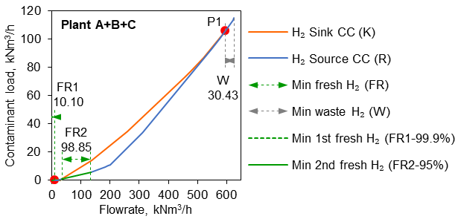
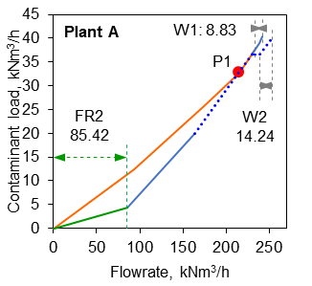
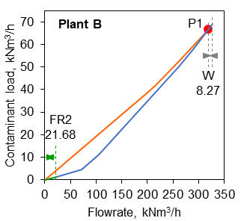
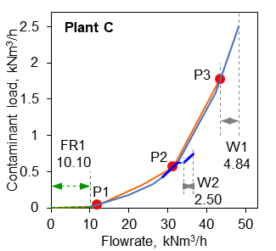
4. Results and Discussion
    Ideal target of Total Site Hydrogen Integration
    Identify cross-plant streams by revising the waste hydrogen discharge

Slide 14
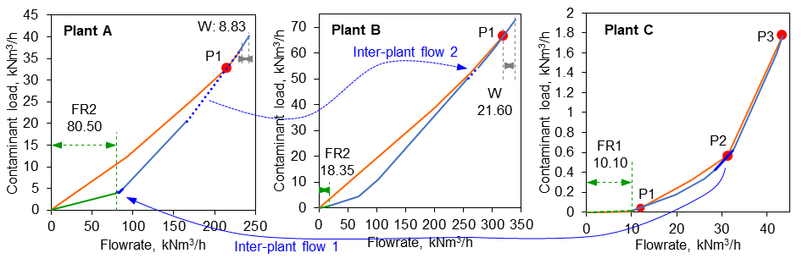
Multi-Resource Total Site H₂ Integration
    Final solution of Multi-Resource Pinch Analysis of Total Site H₂ Integration
      FR2-95% consumption reduced by 7.7 % (8.25 kNm3/h)
      Waste hydrogen discharge reduced by 21.3 % (8.25 kNm3/h)

Slide 15
Multi-Resource Total Site H₂ Integration

Slide 16
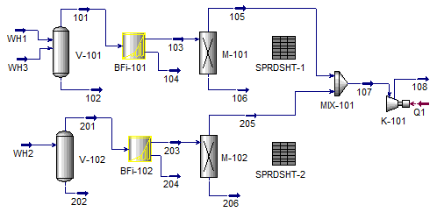
Optimisation of Waste H₂ Regeneration
    Waste H₂ purification process by membrane separation
No membrane separation module in Aspen HYSYS
A membrane separation model is established by combining Component Splitter, Spreadsheet and Adjust function unit in Aspen HYSYS
Flowsheet of separation and purification process

Slide 17
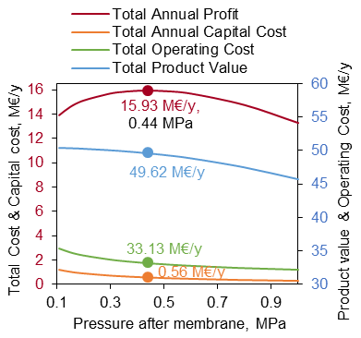
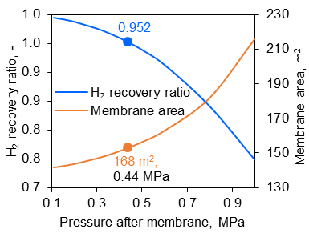
Process optimisation
    Optimise the separation and purification process
(a) pressure vs membrane separation
(b) pressure vs annual economic benefit
The influence of pressure on the waste hydrogen regeneration process

Slide 18
Results: Economic Benefits
Table 6: Optimal results of each economic benefit
Projects |  | Load |  | Costs
Product Profit | Regenerated H₂ | 1.81 | t/h | 39.51 | M€/y
 | Final waste H₂ | 9.72 | kNm³/h | 10.11 | M€/y
 | Total Product Value |  |  | 49.62 | M€/y
Capital Cost | H₂ membrane | 168 | m² | 0.14 | M€
 | Compressor | 1.97 | MW | 3.21 | M€
 | Piping |  |  | 0.90 | M€
 | Total Capital Cost |  |  | 4.25 | M€
 | Total Annual Capital Cost |  |  | 0.56 | M€/y
Operating Cost | Feed of purification process | 30.4 | kNm³/h | 31.65 | M€/y
 | Power consumption | 1.97 | MW | 1.49 | M€/y
 | Total Operating Cost |  |  | 33.13 | M€/y
Total Annual Profit |  |  |  | 15.93 | M€/y
Payback Period: 3.2 mon. H₂ recovery ratio: 95 %
FR2-95% reduced by 21.3 %; Waste H₂ discharge reduced by 67.6 %

Slide 19
5. Conclusions
    Min FR2-95% consumption and min waste hydrogen discharge are reduced by 21.3 % and 67.6 %
    Presents significant economic benefits: total annual profit 15.93 M€/y, payback period 3.2 mon
    Visualised and simple, clear physical meaning and easy to understand
    Can also be applied to other Mass/Material Integration of inter-plant resource conservation network, e.g. water and CO₂
Future Work
    The effects of multiple contaminants
    Integration of hydrogen and work exchange networks with H₂ pressure

Slide 20

Acknowledgment
    This research has been supported by the EU project “Sustainable Process Integration Laboratory – SPIL”, project No. CZ.02.1.01/0.0/0.0/15_003/0000456 funded by EU “CZ Operational Programme Research, Development and Education”, Priority 1: Strengthening capacity for quality research.

Slide 21






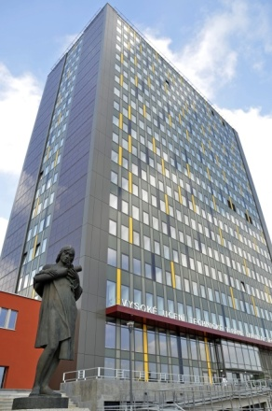






1
24th Conference Process Integration, Modelling and Optimisation for Energy Saving and Pollution Reduction
Brno, Czech Republic
2nd Largest city of CZ
Historical Capital city in Moravia
31 October – 2 November 2021
Villa Tugendhat
Moravian Karst
City hall
1st public building in the world to use Thomas Edison’s electric lamps
City View
Mahen Theatre
Medlánky

Slide 22




SPECIAL SESSION:
Integration of Smart Cities and Smart Industry for Circular Economy: Energy, Water and Waste to Secondary raw material for Sustainable Future
Invitation Code: sd21iscsi
Contact: fan@fme.vutbr.cz; varbanov@fme.vutbr.cz klemes@fme.vutbr.cz
Website: https://www.dubrovnik2021.sdewes.org/special-sessions
Deadline: Abstract (archival paper) December 15, 2020
Abstract (conference paper) August 30, 2021

Slide 23
Thank you for your attention

