Slide 1
Industrial symbiosis for solving problem of organic waste generation in retail
III International Scientific Conference “Sustainable and efficient use of energy, water and natural resources – SEWAN-2021”
Authors: V. Savoskula, A. Novikova, A. Yeremenko, S. Antipova, O. Sergienko
Affiliations: Saint Petersburg State University of Information Technologies, Mechanics and Optics (ITMO University), 49, Kronverkskiy pr., Saint-Petersburg, Russia, 197101
Saint-Petersburg, April 19-24, 2021
Notes:
Уважаемые члены совета, вашему вниманию предлагается доклад по диссертационной работе «Анализ энергетической эффективности систем утилизации теплоты вытяжного воздуха активного типа».
Научным руководителем данной работы является Сулин Александр Борисович.

Slide 2
III International Scientific Conference on “Sustainable and Efficient Use of Energy, Water and Natural Resources”
Industrial symbiosis for solving problem of organic waste generation in retail
V. Savoskula, A. Novikova, A. Yeremenko, S. Antipova, O. Sergienko
Saint Petersburg State University of Information Technologies, Mechanics and Optics (ITMO University), 49, Kronverkskiy pr., Saint-Petersburg, Russia, 197101
Keywords: organic waste, industrial symbiosis, retail
Research Objective:
A third of all food products are lost or thrown away every year in the world – about 1.3 billion tons per year, or 7.5 trillion dollars. At the same time, in Russia, according to Rosstat, food losses are 0.6%, and according to experts - more than 40%. To date, according to AKORT (Association of Retail Companies) and X5 Retail Group, Russian retail produces about 700 tons of food waste per year. The main share of which - about 45% - are expired plant products - vegetables and fruits, about 20-25% are products with a short consumption period and about 30% are meat, poultry and fish.
The main goal of the study is to consider the possibility of biogas production and further energy production from organic waste of retail chains using the approach of industrial symbiosis. Thus, a solution to the problem of organic waste and energy in the Russian region is proposed.

Slide 3
III International Scientific Conference on “Sustainable and Efficient Use of Energy, Water and Natural Resources”
Industrial symbiosis for solving problem of organic waste generation in retail
V. Savoskula, A. Novikova, A. Yeremenko, S. Antipova, O. Sergienko
Saint Petersburg State University of Information Technologies, Mechanics and Optics (ITMO University), 49, Kronverkskiy pr., Saint-Petersburg, Russia, 197101
Keywords: organic waste, industrial symbiosis, retail
Results
The overall objective have been achieved through:
Study of the legislative framework for the possibility of building the principle of industrial symbiosis in one of the regions of Russia
Building a model of industrial symbiosis of retail trade with the possibility of obtaining biogas from organic waste and further obtaining energy and other by-products. At this stage, the analysis of the legal framework made it possible to conclude that the current situation with the processing of organic waste is burdened with the costs of Russian legislation. The situation is such that landfill disposal is the simplest and cheapest option for handling this type of waste. The processing of organic waste by transferring it to peasant farms or obtaining energy resources is not stimulated by the state at the proper level, there is no motivational system for the implementation of such environmental initiatives, there are no subsidies and benefits. Even donating surplus food to charity is taxed.

Slide 4
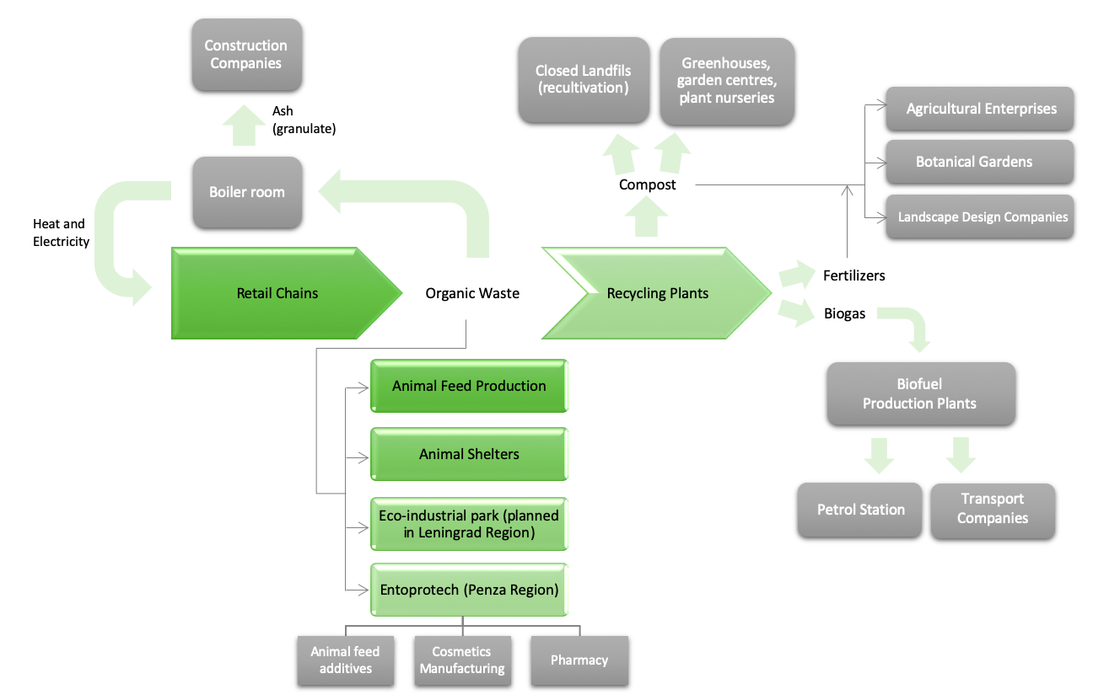
III International Scientific Conference on “Sustainable and Efficient Use of Energy, Water and Natural Resources”
Industrial symbiosis for solving problem of organic waste generation in retail
V. Savoskula, A. Novikova, A. Yeremenko, S. Antipova, O. Sergienko
Saint Petersburg State University of Information Technologies, Mechanics and Optics (ITMO University), 49, Kronverkskiy pr., Saint-Petersburg, Russia, 197101
Keywords: organic waste, industrial symbiosis, retail
The model of industrial symbiosis may include: transfer to the participants of the symbiotic system for use as raw materials, autonomous use and centralized management of household waste.
Industrial Symbiosis model for organic waste of retail chains

Slide 5
III International Scientific Conference on “Sustainable and Efficient Use of Energy, Water and Natural Resources”
Industrial symbiosis for solving problem of organic waste generation in retail
V. Savoskula, A. Novikova, A. Yeremenko, S. Antipova, O. Sergienko
Saint Petersburg State University of Information Technologies, Mechanics and Optics (ITMO University), 49, Kronverkskiy pr., Saint-Petersburg, Russia, 197101
Keywords: organic waste, industrial symbiosis, retail
Conclusions
The use of the industrial symbiosis approach - the use of waste from one enterprise in the production process of another enterprise - allows you to optimize the use of resources, reducing environmental impacts by closing resource chains, thereby contributing to the development of a circular economy.
Building a model of industrial symbiosis is a tool that can be used as an effective tool for solving organic waste problems. In the best way of functioning of industrial symbiosis, 100% of organic waste will not be disposed of in landfills, at the same time, all the electricity needed for the city will be generated using biogas from organic waste. This scenario is consistent with the “perfect symbiosis” defined by Albino et al. as a condition under which waste is not disposed of and primary resources are not purchased outside the considered system.
References
1. Research by the Center for the Development of the Consumer Market of the Moscow School of Management Skolkovo «Food losses and organic waste in the consumer market of the Russian Federation», Moscow. 2020. [Electronic resource]. – https://sk.skolkovo.ru/storage/file_storage/1de06cc3-d069-49e4-9980-8088d743057/SKOLKOVO_CMDC_2019-12-06_001.pdf
2. Business Vector News Agency Article «Waste-free trade: why do X5 and Magnit collect bottles and recycle packaging». 2019. [Electronic resource]. – https://www.business-vector.info
3. Albino V., Fraccascia L., Savino T. // Procedia Engineering. 2015. № 118. P. 950 – 957.
Acknowledgement

Slide 6
III International Scientific Conference on “Sustainable and Efficient Use of Energy, Water and Natural Resources”
Industrial symbiosis for solving problem of organic waste generation in retail
V. Savoskula, A. Novikova, A. Yeremenko, S. Antipova, O. Sergienko
Saint Petersburg State University of Information Technologies, Mechanics and Optics (ITMO University), 49, Kronverkskiy pr., Saint-Petersburg, Russia, 197101
Keywords: organic waste, industrial symbiosis, retail
Thank you for your attention!
Authors: V. Savoskula, A. Novikova, A. Yeremenko,
S. Antipova, O. Sergienko
Affiliations: Saint Petersburg State University of Information Technologies, Mechanics and Optics (ITMO University), 49, Kronverkskiy pr., Saint-Petersburg, Russia, 197101
Contact details: vasavoskula@itmo.ru, anastasia.d.novikova@yandex.ru

